Slide 1

Yunchuan Xiang , Yingzhi Ye, Peng Feng, Xiankai Pang, Xiaofei Lan, Qingquan Jiang, Ningfeng Zhang and Hui Li

Slide 2
01
Research Background
02
Research Questions
CONTENTS
03
Research Significance
04
Research Methods
05
Research Conclusions

Slide 3
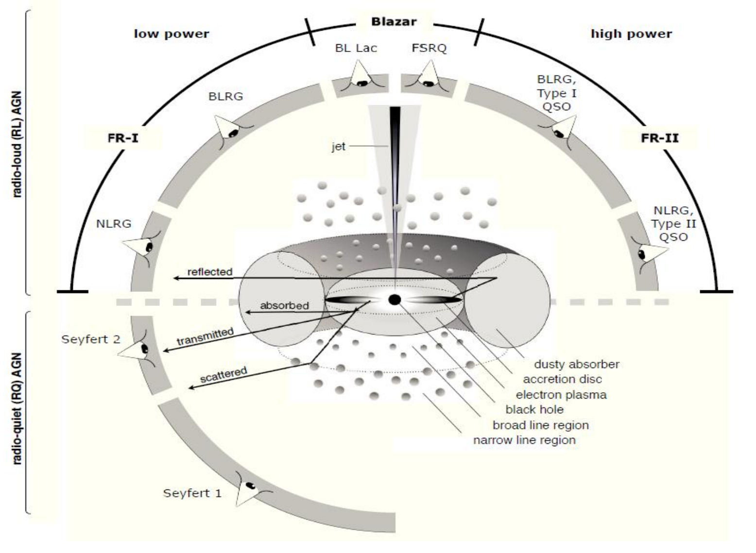
Research background
●Exceptionally high luminosities
●Pronounced and rapid variability
●Intense and highly variable polarization
Blazar
●Apparent superluminal motion observed
in the radio regime
●Non-thermal continuum spectra dominated
by nuclear emission
●Strong gamma-ray emission
The unified model of Active Galactic Nuclei

Slide 4
Research background
Blazars
（Blazar dichotomy）
Flat Spectrum Radio Quasars (FSRQs)
BL Lacertae objects (BL Lacs)
The equivalent width (EW) of the emission lines in their spectra.
EW > 5 Å
EW < 5 Å

Slide 5
Research Questions
1. What are the statistical characteristics of the flux distributions for BZBs and BZQs?
2. To what extent do these distributions truly differ?
The key questions unresolved:
3. What physical mechanisms drive these differences?
4. Can we construct a unified distribution model for the flux of BZBs and BZQs that can serve as a new criterion for identifying new candidates of these subclasses?
5.Utilizing the characteristics of statistical differences in multi-band fluxes, how many pairs of associated objects between 5BZCAT and 4FGL-Xiang-DR2 can be identified?
Blazars
97.09%
AGNs
56.3%
Blazar is one of the most prevalent gamma-ray sources in the all-sky survey
The total γ-ray sources
in the 4FGL-DR4

Slide 6
Research Significance
(a) To provide key observational evidence for systematically revealing the fundamental differences between BZBs and BZQs in their multi-band energy output and radiation mechanisms.
(b) By precisely quantifying the differences in these multi-band flux distributions, this study will provide key observational constraints on the radiation mechanisms and particle acceleration processes of these two subclasses, and offer new supporting evidence for the blazar dichotomy.
(c) To explore novel classification criteria based on the statistical distributions of multi-band flux, thereby establishing a more robust classification paradigm that overcomes the limitations of traditional methods reliant on single, variable optical spectral observations.
(d) Identifying and confirming more blazar candidates, along with analyzing the statistical properties of BZBs and BZQs based on existing blazar samples, is of great significance for studying the classification, evolution, jet dynamics, non-thermal radiation mechanisms, and contributions of blazars to the cosmic high-energy background.

Slide 7
Research Methods
Retrieving positional uncertainties from 5BZCAT_err and DR2
Calculating spatial association probabilities between 5BZCAT_err and DR2
Four-step analytical pipeline
Extracting multi-wavelength fluxes of 5BZCAT_err from NED
Quantifying and modeling the multi-band flux distribution of BZBs and BZQs

Slide 8
Research Methods （Pipeline 1）
Content 1:
Constructed 5BZCAT_err
Identified 62 sources without positional uncertainty
Selected the closest candidates using astroquery
Retrieved original information from 5BZCAT
Replaced the original position with that of the candidate
Retrieved elliptical uncertainties via astroquery using source names
Check spatial correlation using Matplotlib
Retrieved the positional uncertainties of 3499 sources
Identified 62 candidates with elliptical positional uncertanties
Merged data to generate 5BZCAT_err

Slide 9
Research Methods（Pipeline 2）
Content 2: Spatial Cross-matching
4FGL-Xiang-DR2
5BZCAT_err
Perform spatial cross-matching using nway
P_{any}＞85% & P_{i}＞85%
Validate cross-matching results using TOPCAT
Performed visual inspection using DS9
Completed the spatial correlation analysis

Slide 10
Research Methods（Pipeline 3.1）
Content 3: Collect multi-band fluxes of 5BZCAT_err
Extract source names from 5BZCAT_err
Retrieve multi-wavelength fluxes using astroquery
Identify sources with available flux data
Re-screen sources without flux data
Standardize data formats and units
Classify flux data in each waveband
BZB
BZQ
Complete the collection of multi-band fluxes

Slide 11
Research Methods（Pipeline 3.2）
Content 4: Statistical analysis of multi-wavelength flux distributions
Generate histograms with Matplotlib
Exclude 17 blazar candidates from the full sample
Determine the conversion factor λ
Apply the Box-Cox transform using SciPy
Remove outliers using
the LOF algorithm
Perform histogram analysis using SciPy
Caculate JSD using SciPy
Compute Box-Cox values for17 blazar candidates
Fit multi-band fluxes with a truncated normal distribution
Conduct KS and CVM tests
Compute eight key statistical metries
P value ＞0.05
P value ＜0.05
Determine the optimal distribution model
Caculate the MAD between
BZBs and BZQs
Quantify the difference between distributions
Compute z-scores
Compute 1σ and 2σ CIs
Characterize the distributional properties
Consistency analysis of flux distribution characteristics
Validate the common-source hypothesis in cross-identification

Slide 12
Research Conclusions(1)
(1) Based on 16 years of Fermi-LAT data, we reanalyzed the DR1 catalog using Fermipy to supplement the missing elliptical positional errors, and ultimately released the updated DR2 catalog, which provides more precise and comprehensive parameters.

Slide 13
Research Conclusions(2)
(2) To remedy the lack of positional errors in 5BZCAT, we integrated it with NED, populated uncertainties for all 3,561 sources, and constructed a new catalog, 5BZCAT_err, suitable for probabilistic cross-matching.
5BZCAT blazar catalog
NED database
5BZCAT_err

Slide 14
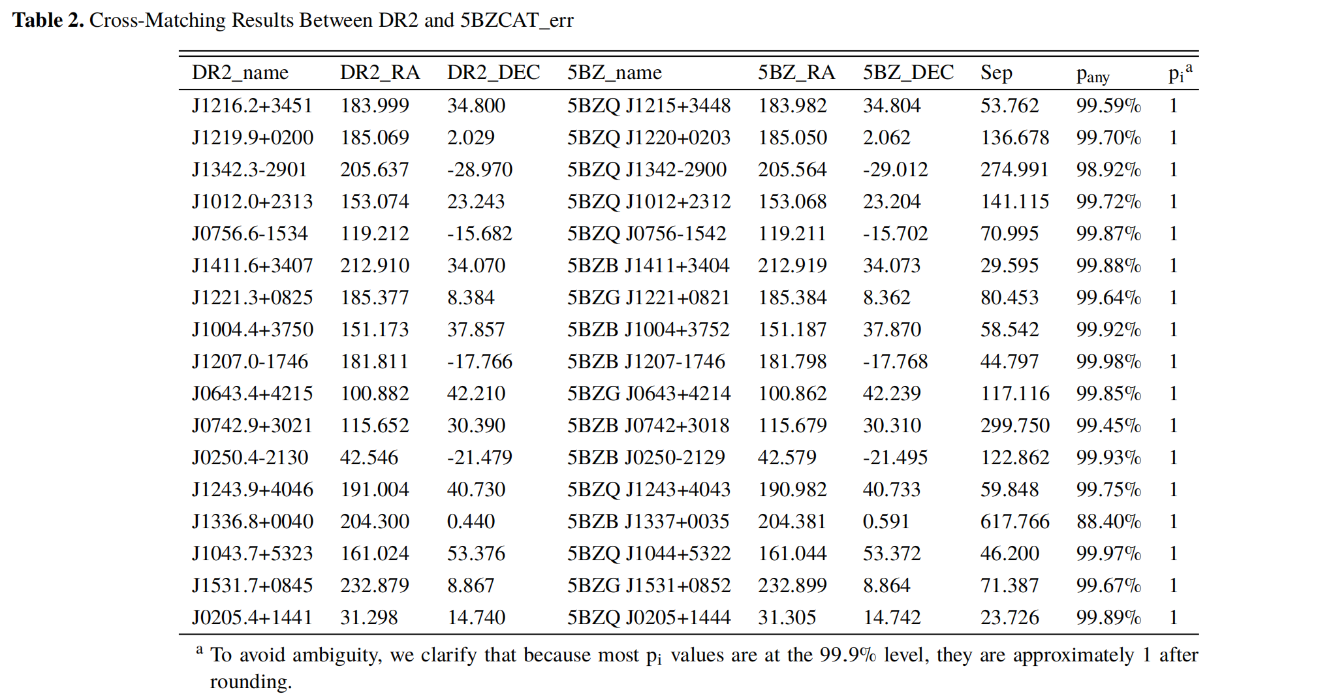
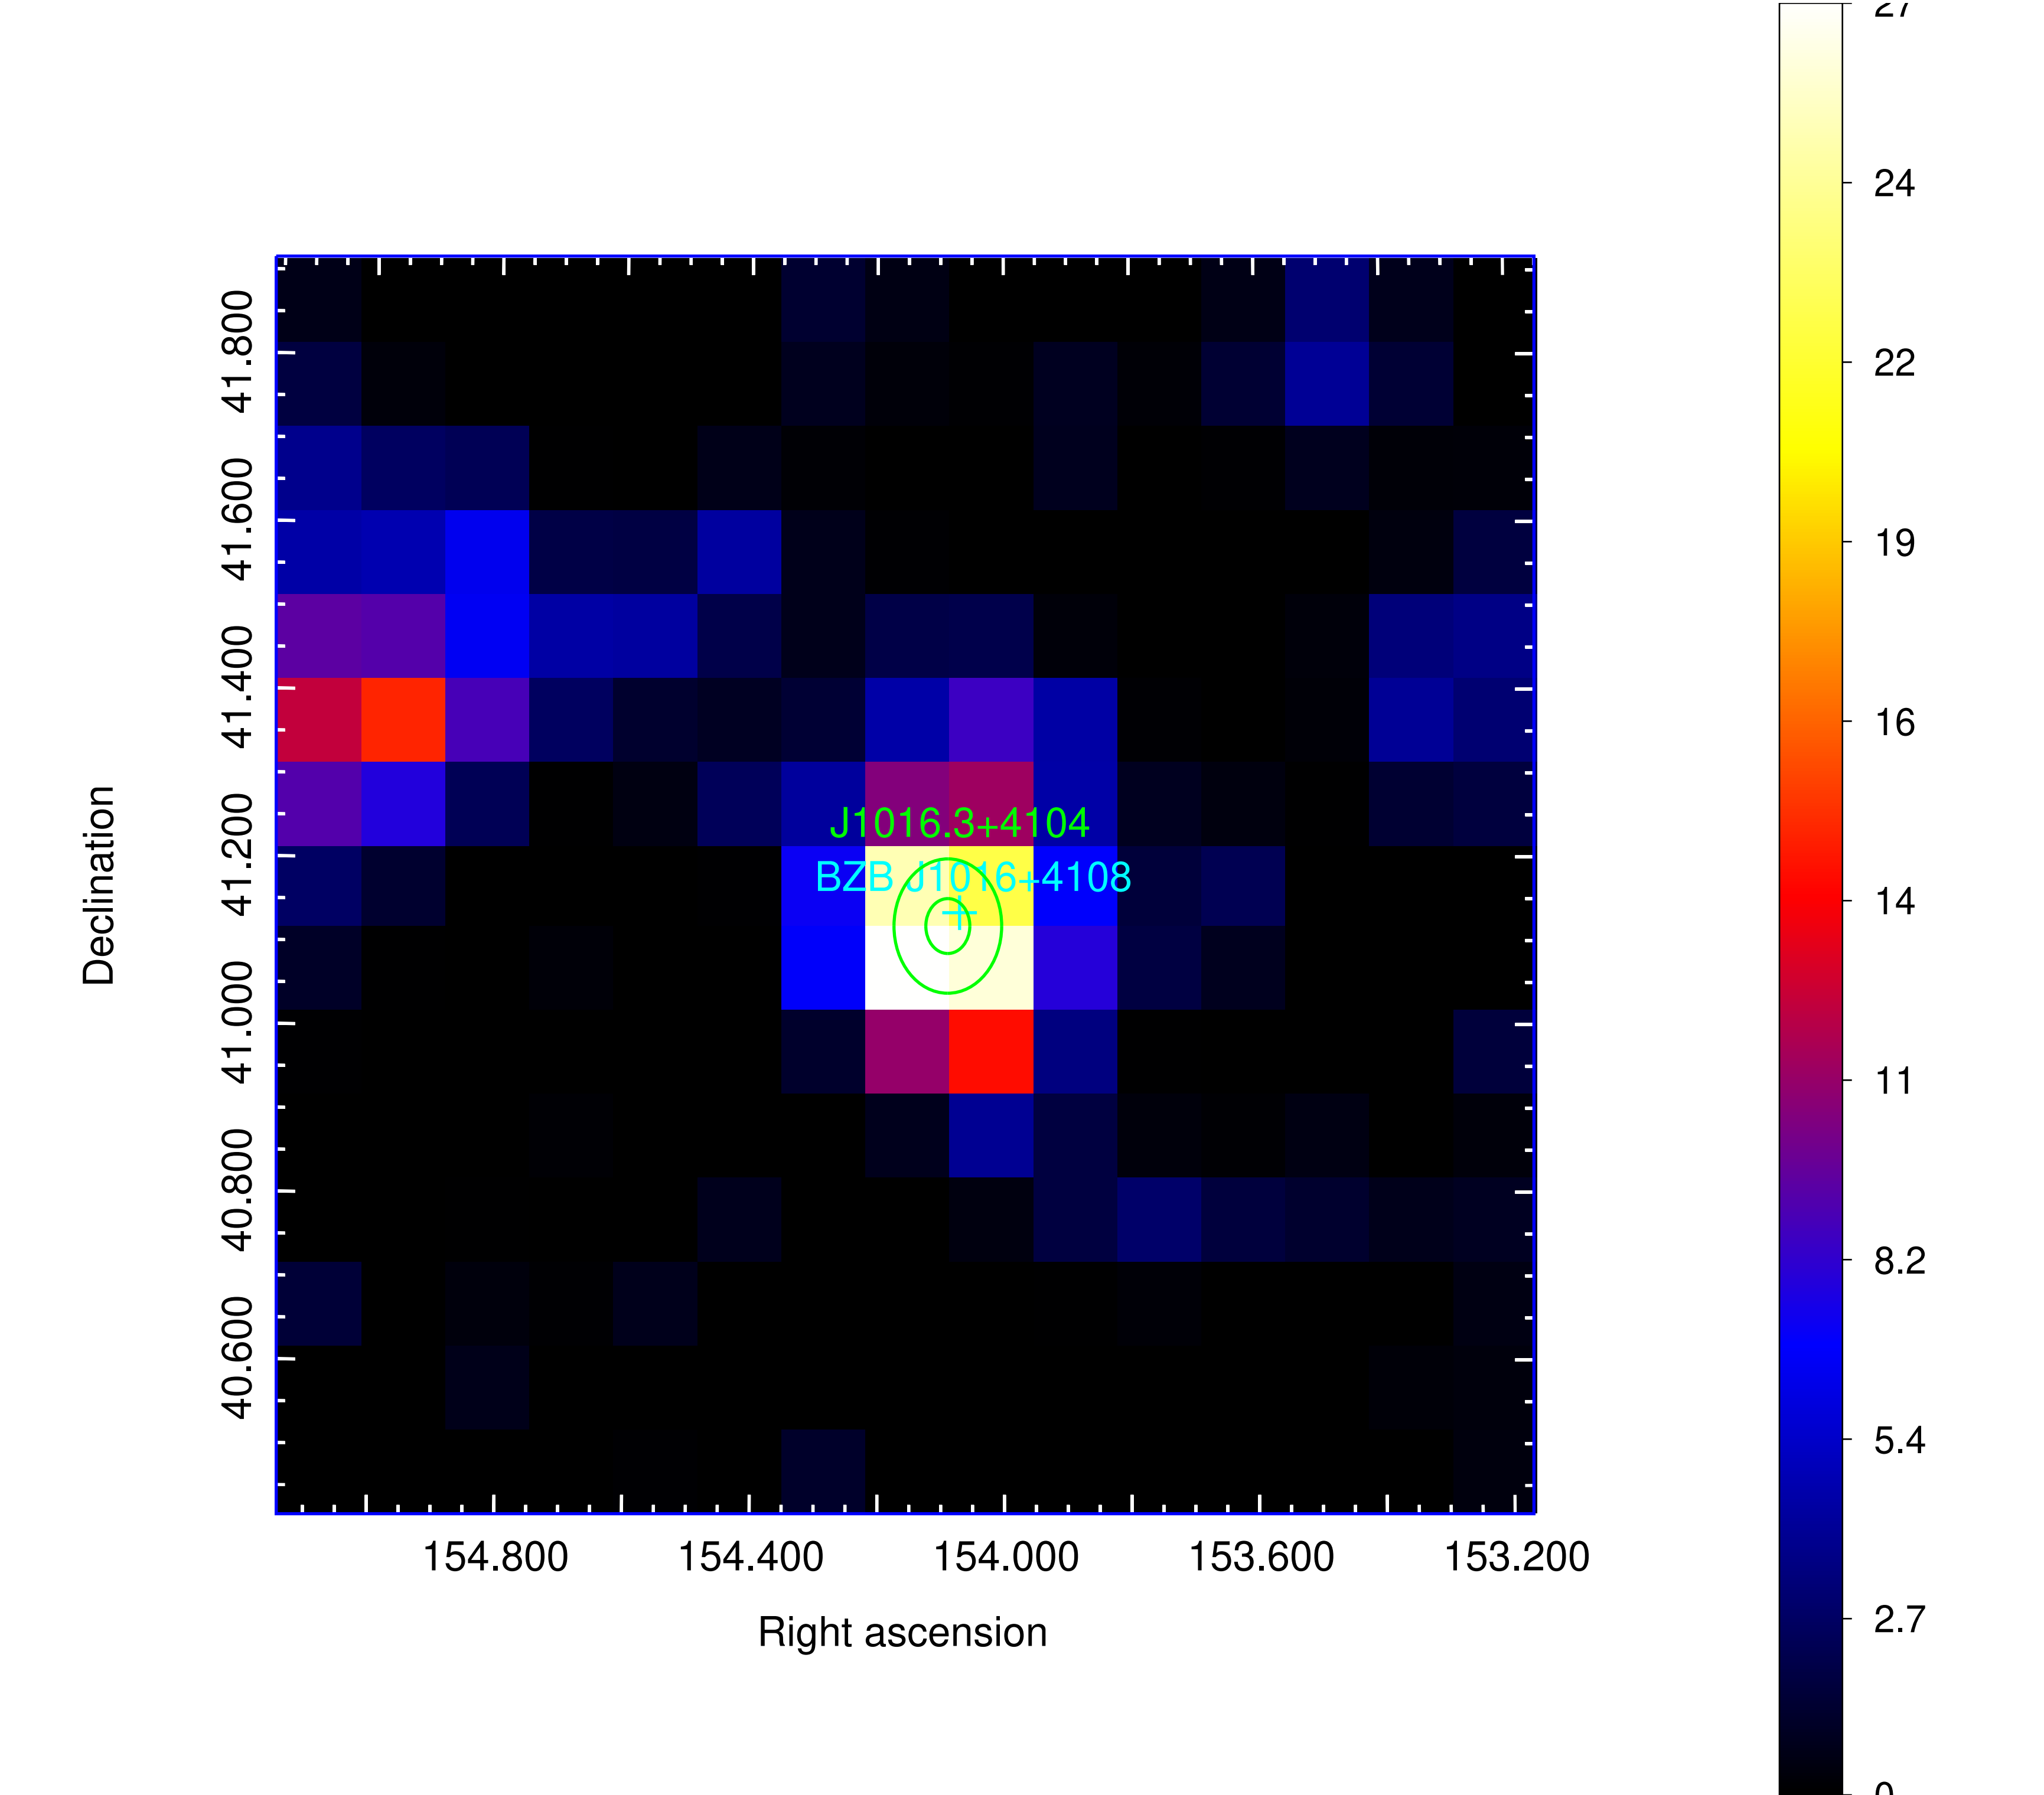
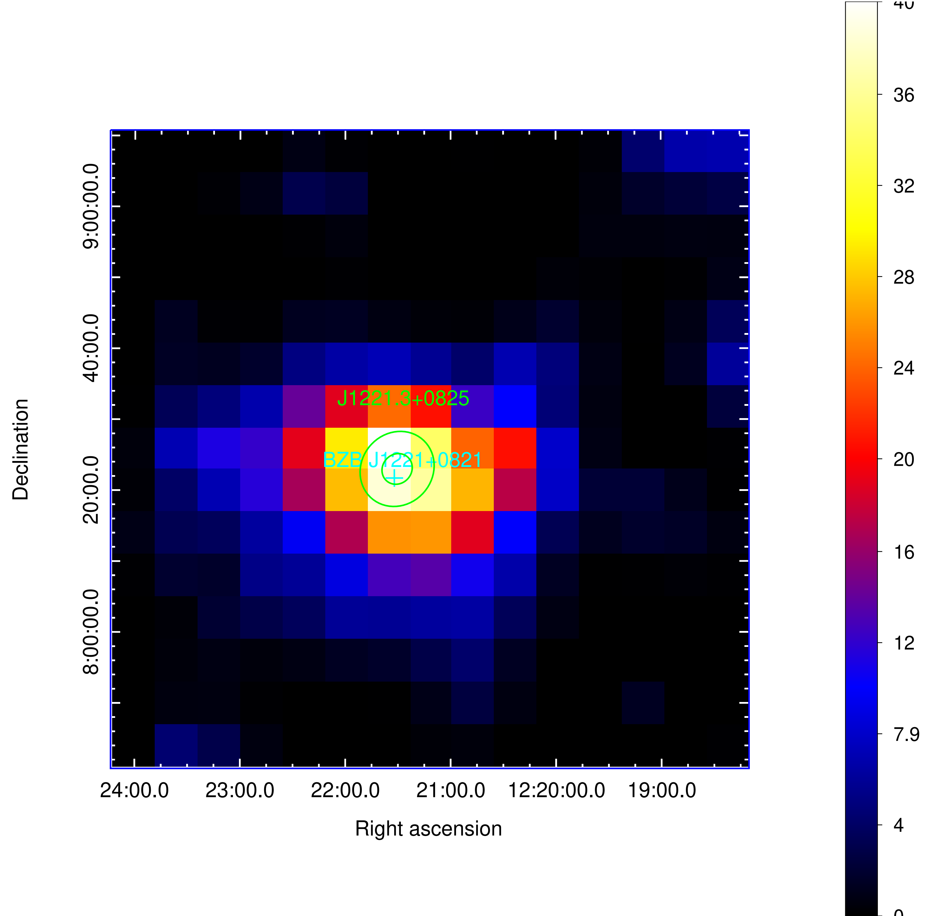
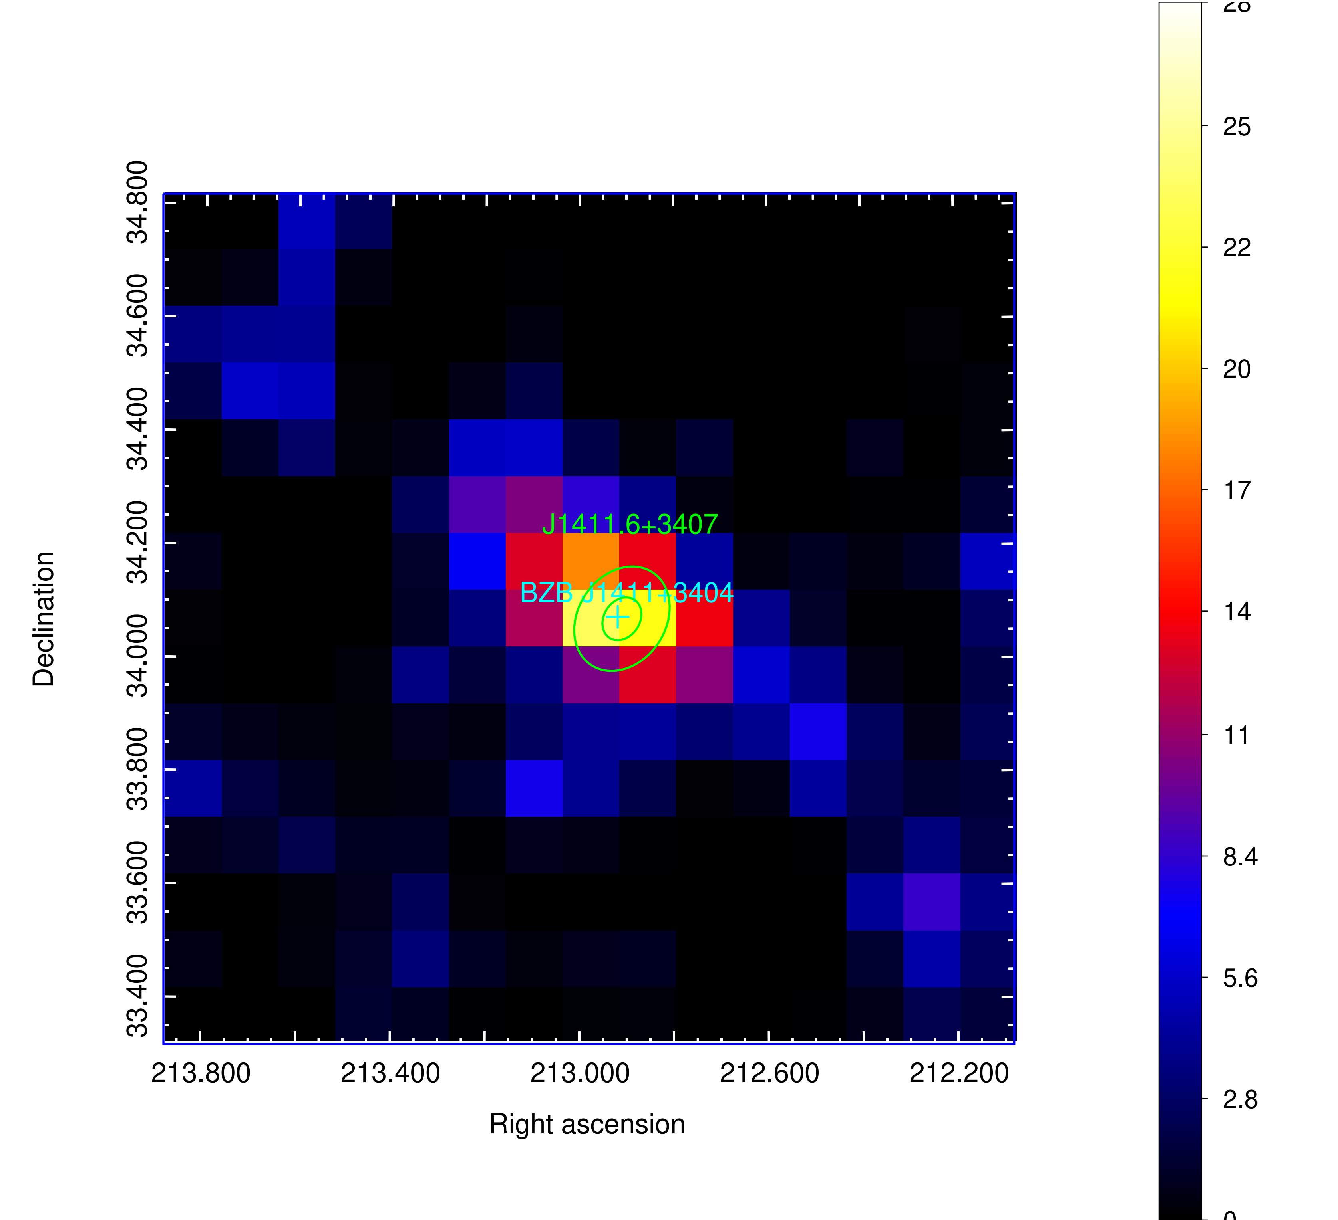
Research Conclusions(3)
(3) By cross-matching DR2 with 5BZCAT_err, we identified 17 high-confidence GeV blazars. Their associations show high probabilities and were independently verified using TOPCAT and DS9.
DR2
5BZCAT_err
17 high-confidence GeV blazars

Slide 15
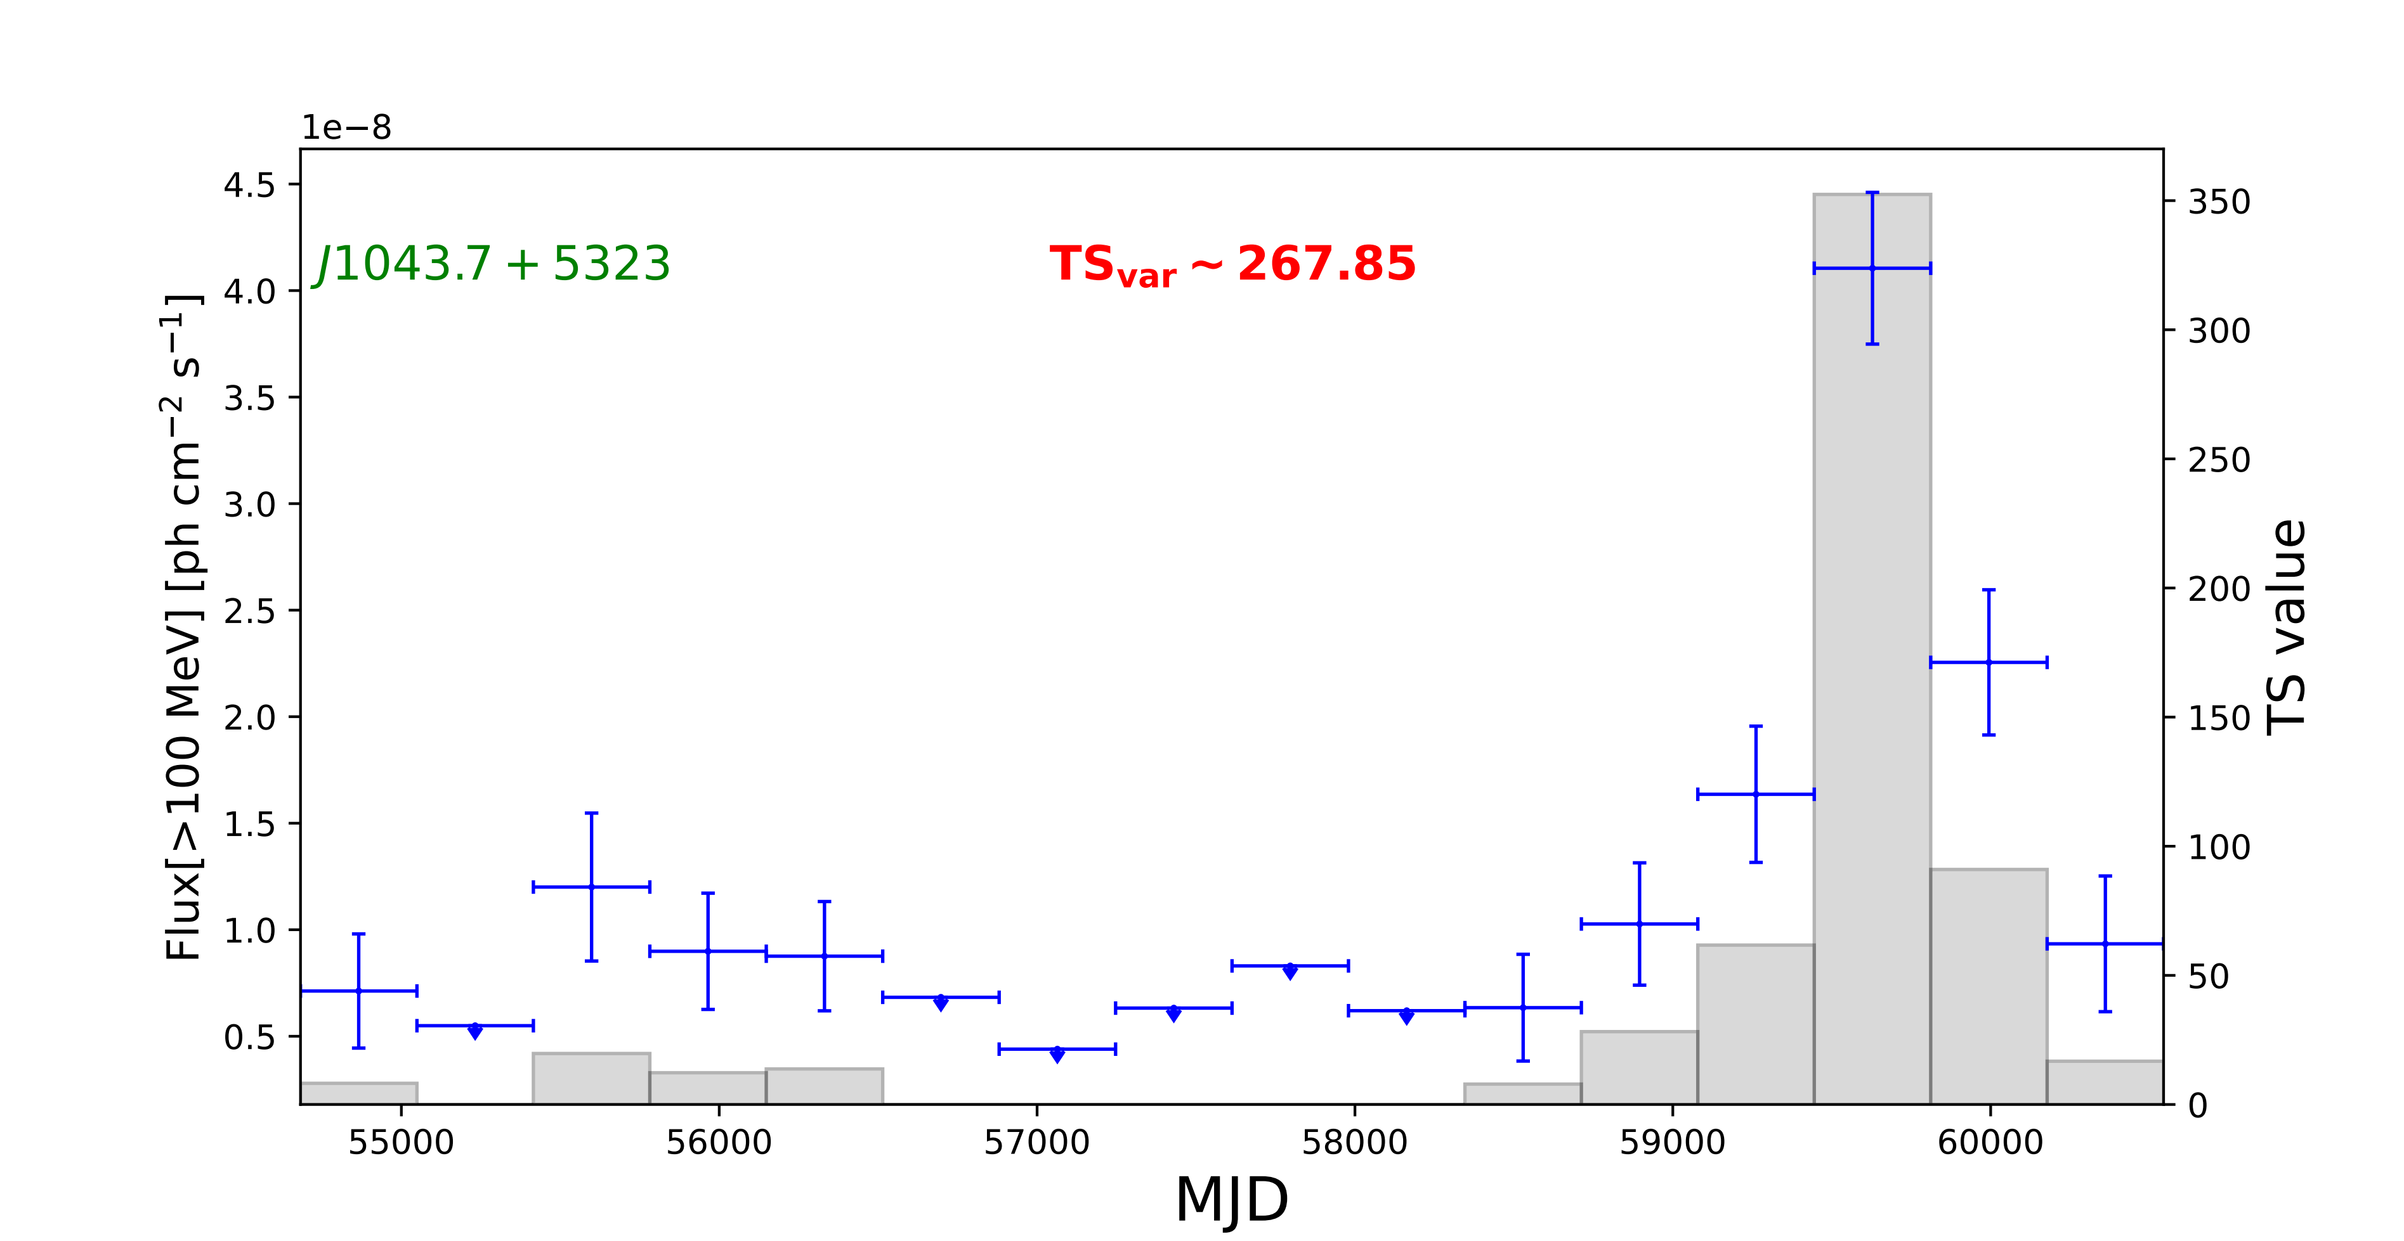
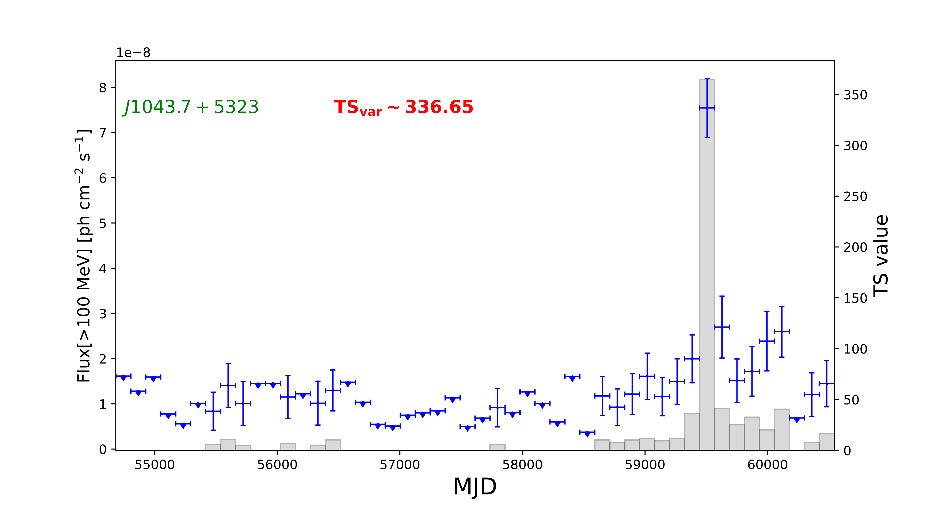
Research Conclusions(4)
(4) Using Fermipy, we analyzed the 17 new GeV blazars and found no significant spatial extension or spectral curvature. Most sources show no significant variability; the exception is J1043.7+5323, which exhibits strong variability across multiple timescales.

Slide 16
Research Conclusions (5)
(5) To compare the flux distributions of BZBs and BZQs, we collected multi-wavelength flux data from 5BZCAT_err and quantified their differences using two methods: MAD for eight statistical indicators and JSD for overall probability distributions. Both methods consistently reveal systematic differences between BZBs and BZQs across all observed bands. Specifically, the MAD analysis identifies kurtosis as the most discriminative metric, while the JSD analysis highlights the 1.4 GHz, 843 MHz, 5 GHz, 0.1–2.4 keV, and 0.3–10 keV bands as showing larger distributional differences compared to other bands.
MAD
8 statistical indicators
Kurtosis is the most discriminative statistical metric.

Slide 17
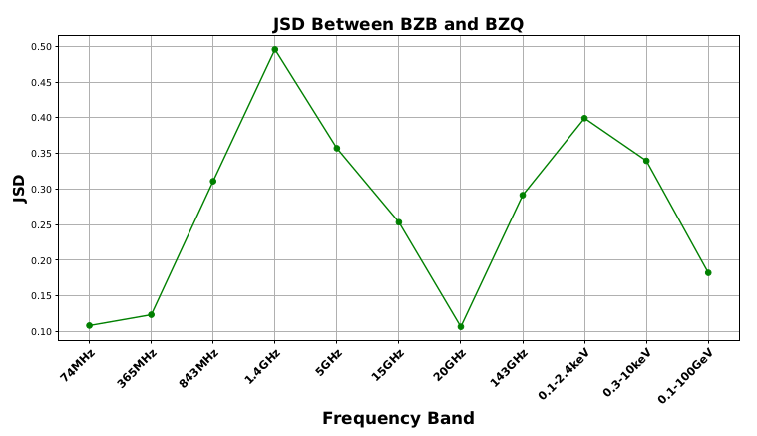
Research Conclusions (5)
(5) To compare the flux distributions of BZBs and BZQs, we collected multi-wavelength flux data from 5BZCAT_err and quantified their differences using two methods: MAD for eight statistical indicators and JSD for overall probability distributions. Both methods consistently reveal systematic differences between BZBs and BZQs across all observed bands. Specifically, the MAD analysis identifies kurtosis as the most discriminative metric, while the JSD analysis highlights the 1.4 GHz, 843 MHz, 5 GHz, 0.1–2.4 keV, and 0.3–10 keV bands as showing larger distributional differences compared to other bands.
The 843MHz, 1.4 GHz, 5GHz, 0.1–2.4 keV and 0.3–10 keV bands show the larger distributional differences.
JSD
The overall probability distributions
JSD>0.3

Slide 18
Research Conclusions (6)
(6) To address the limitations of single-band metrics in blazar classification (e.g., small sample sizes and incomplete data), we propose a multi-messenger joint-analysis pipeline for classification and identification. Building on our “Box-Cox + TND” model, the method quantifies the statistical consistency between a candidate and its parent population, yielding robust decisions. Modeling results indicate that the approach is broadly applicable and accurately fits the flux distributions of BZBs and BZQs.
The “Box-Cox + TND” model
Multi-messenger joint-analysis pipeline
Verify the statistical consistency between a candidate and its parent population
Fits the multi-band flux distributions of BZBs and BZQs

Slide 19
Research Conclusions (7)
(7) We apply a Box-Cox + TND model to test whether the multi-band fluxes of 17 new blazar candidates are consistent with the 5BZCAT population; most candidates fall within 1–2σ CI, supporting correct classifications and the common-source origin.
The multi-band fluxes of 17 new blazar candidates
The multi-band fluxes of 5BZCAT population
The “Box-Cox + TND” model
Most candidates fall within 1–2σ CI

Slide 20
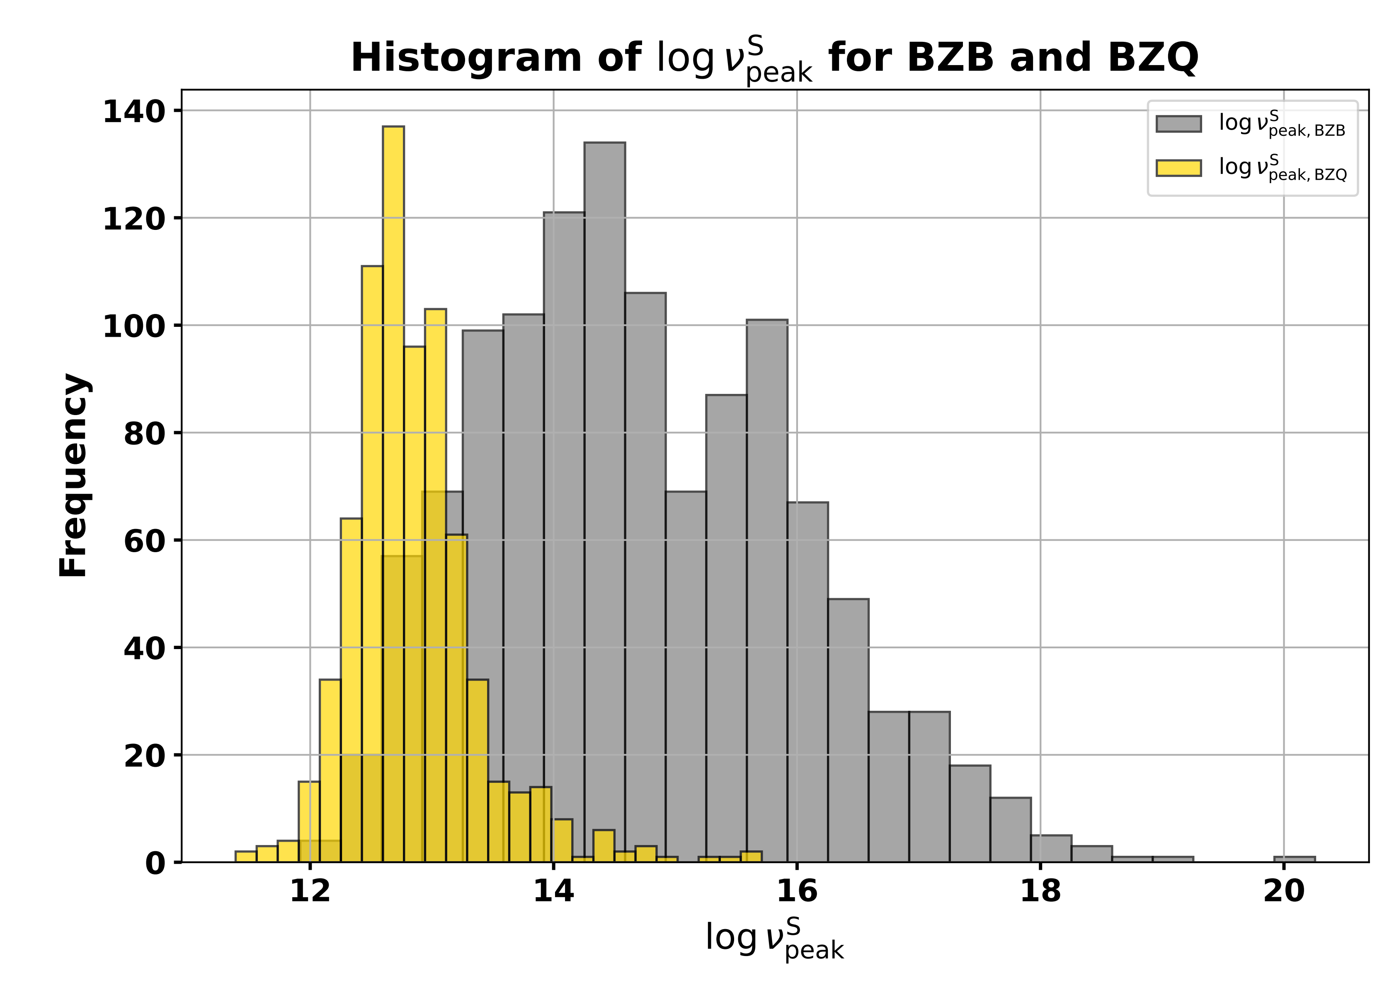
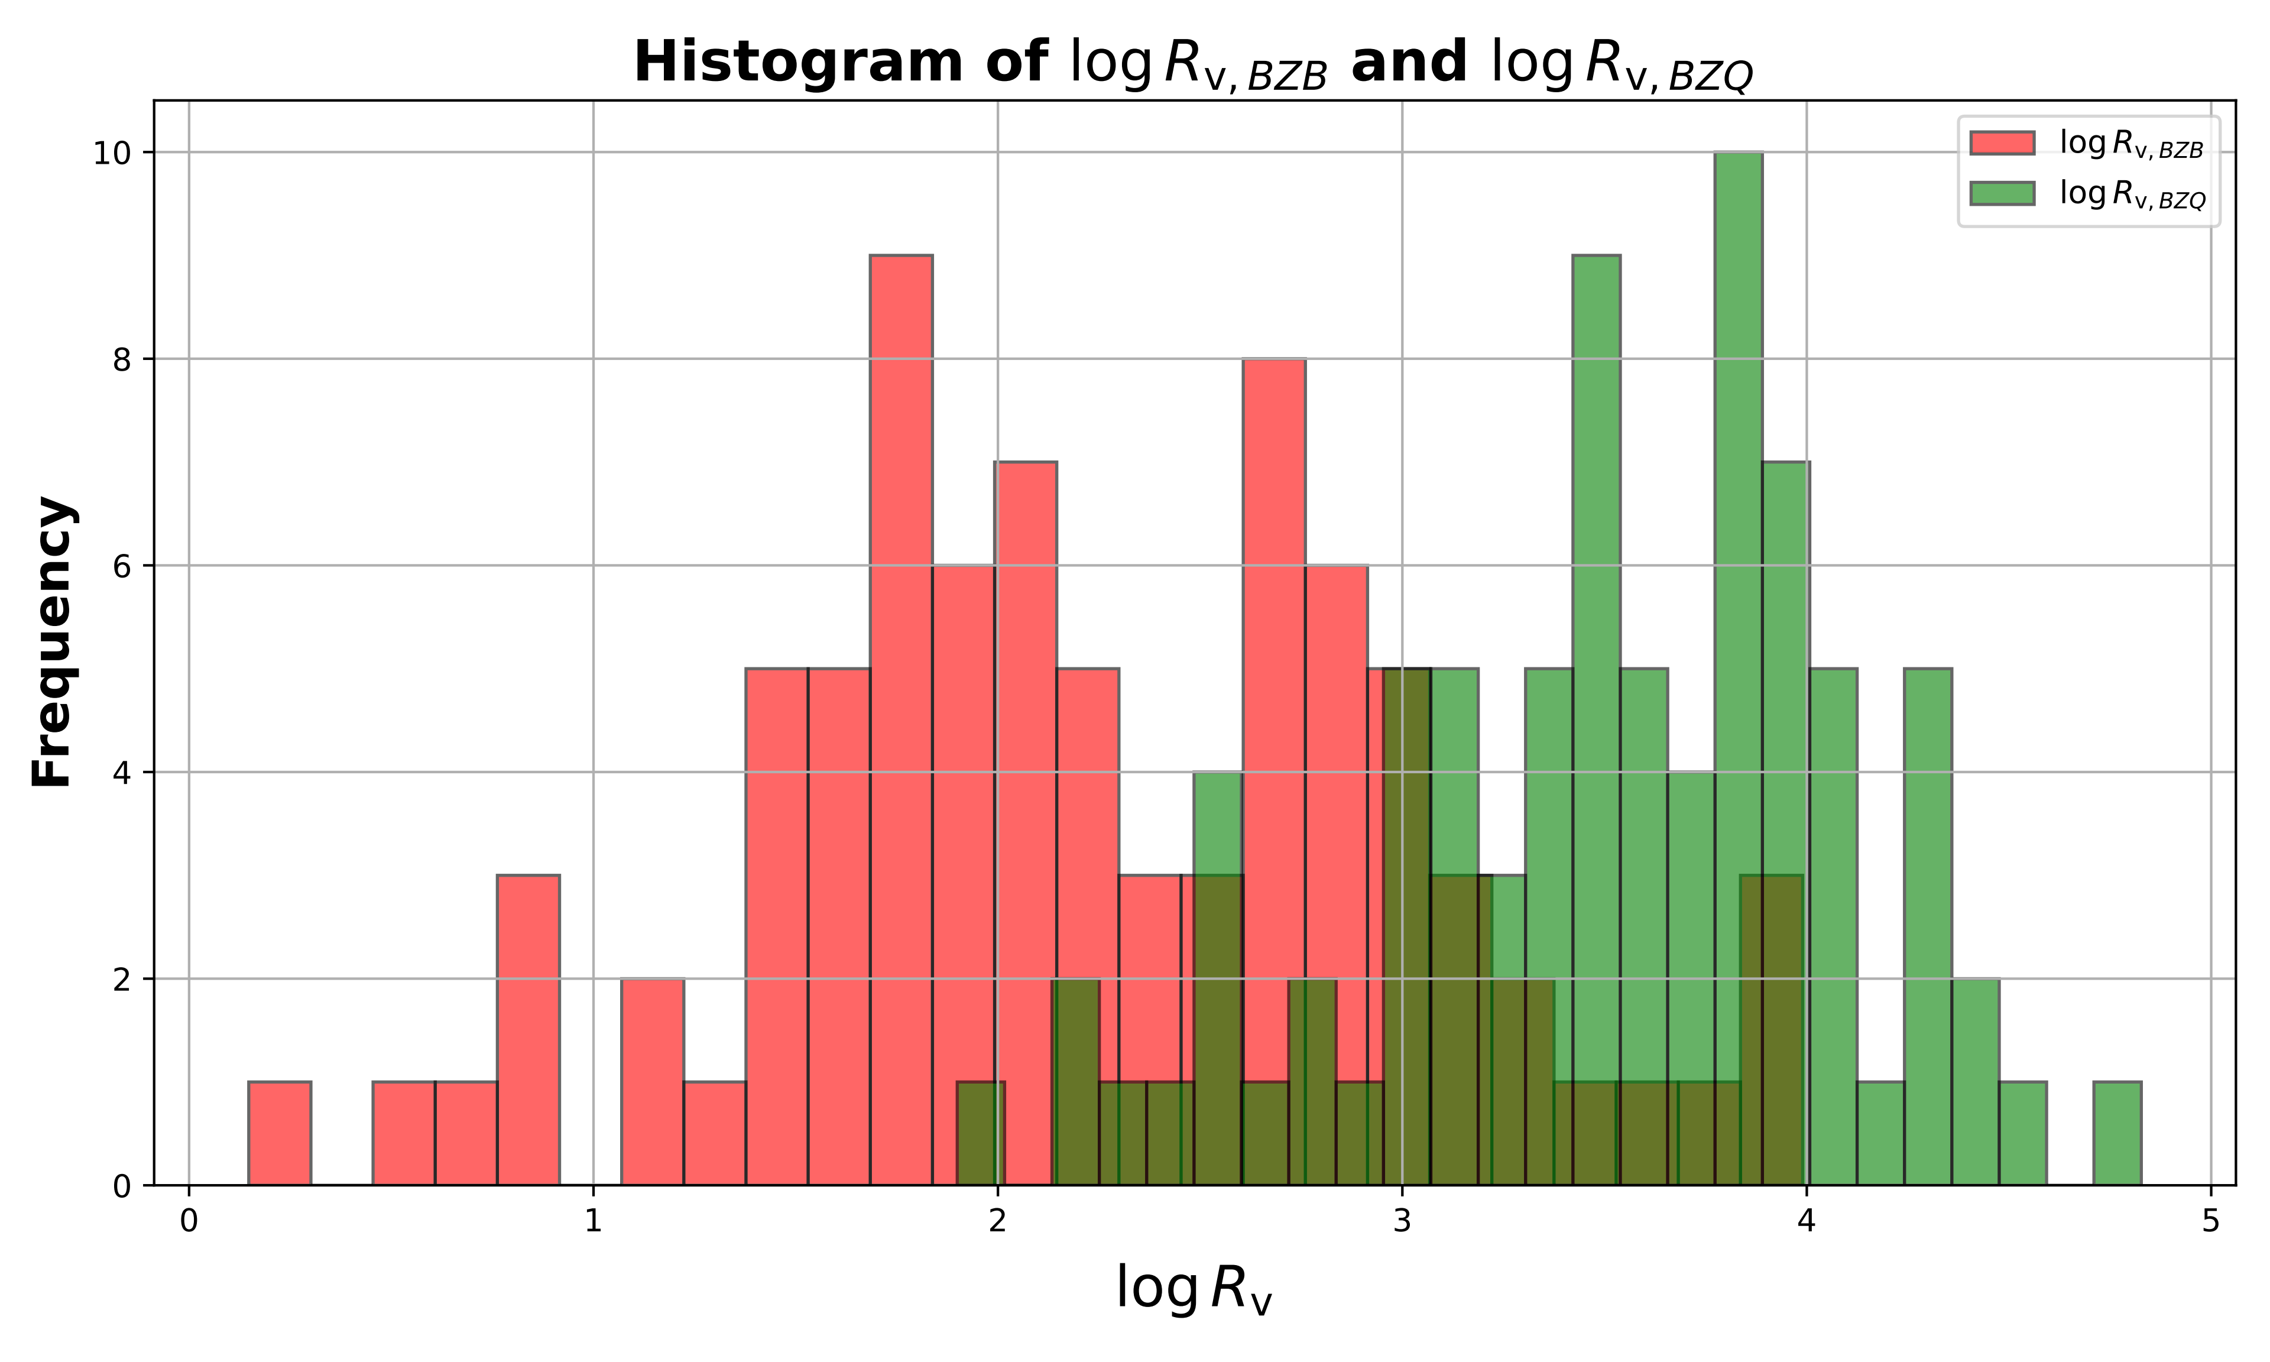
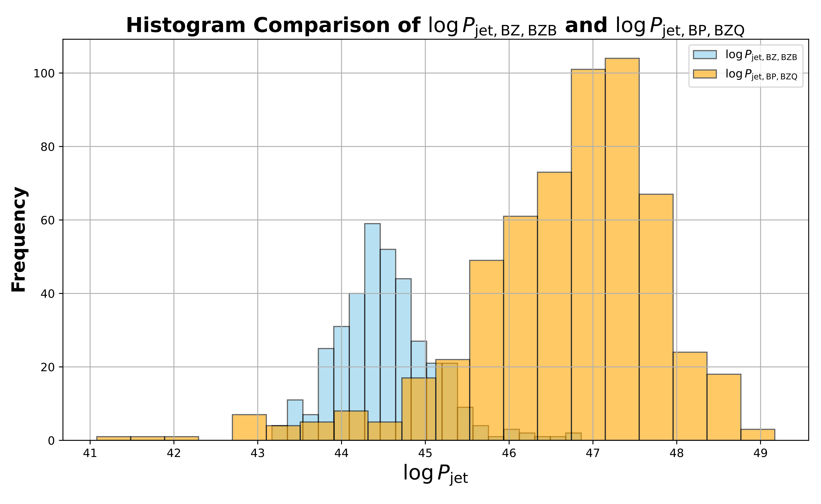
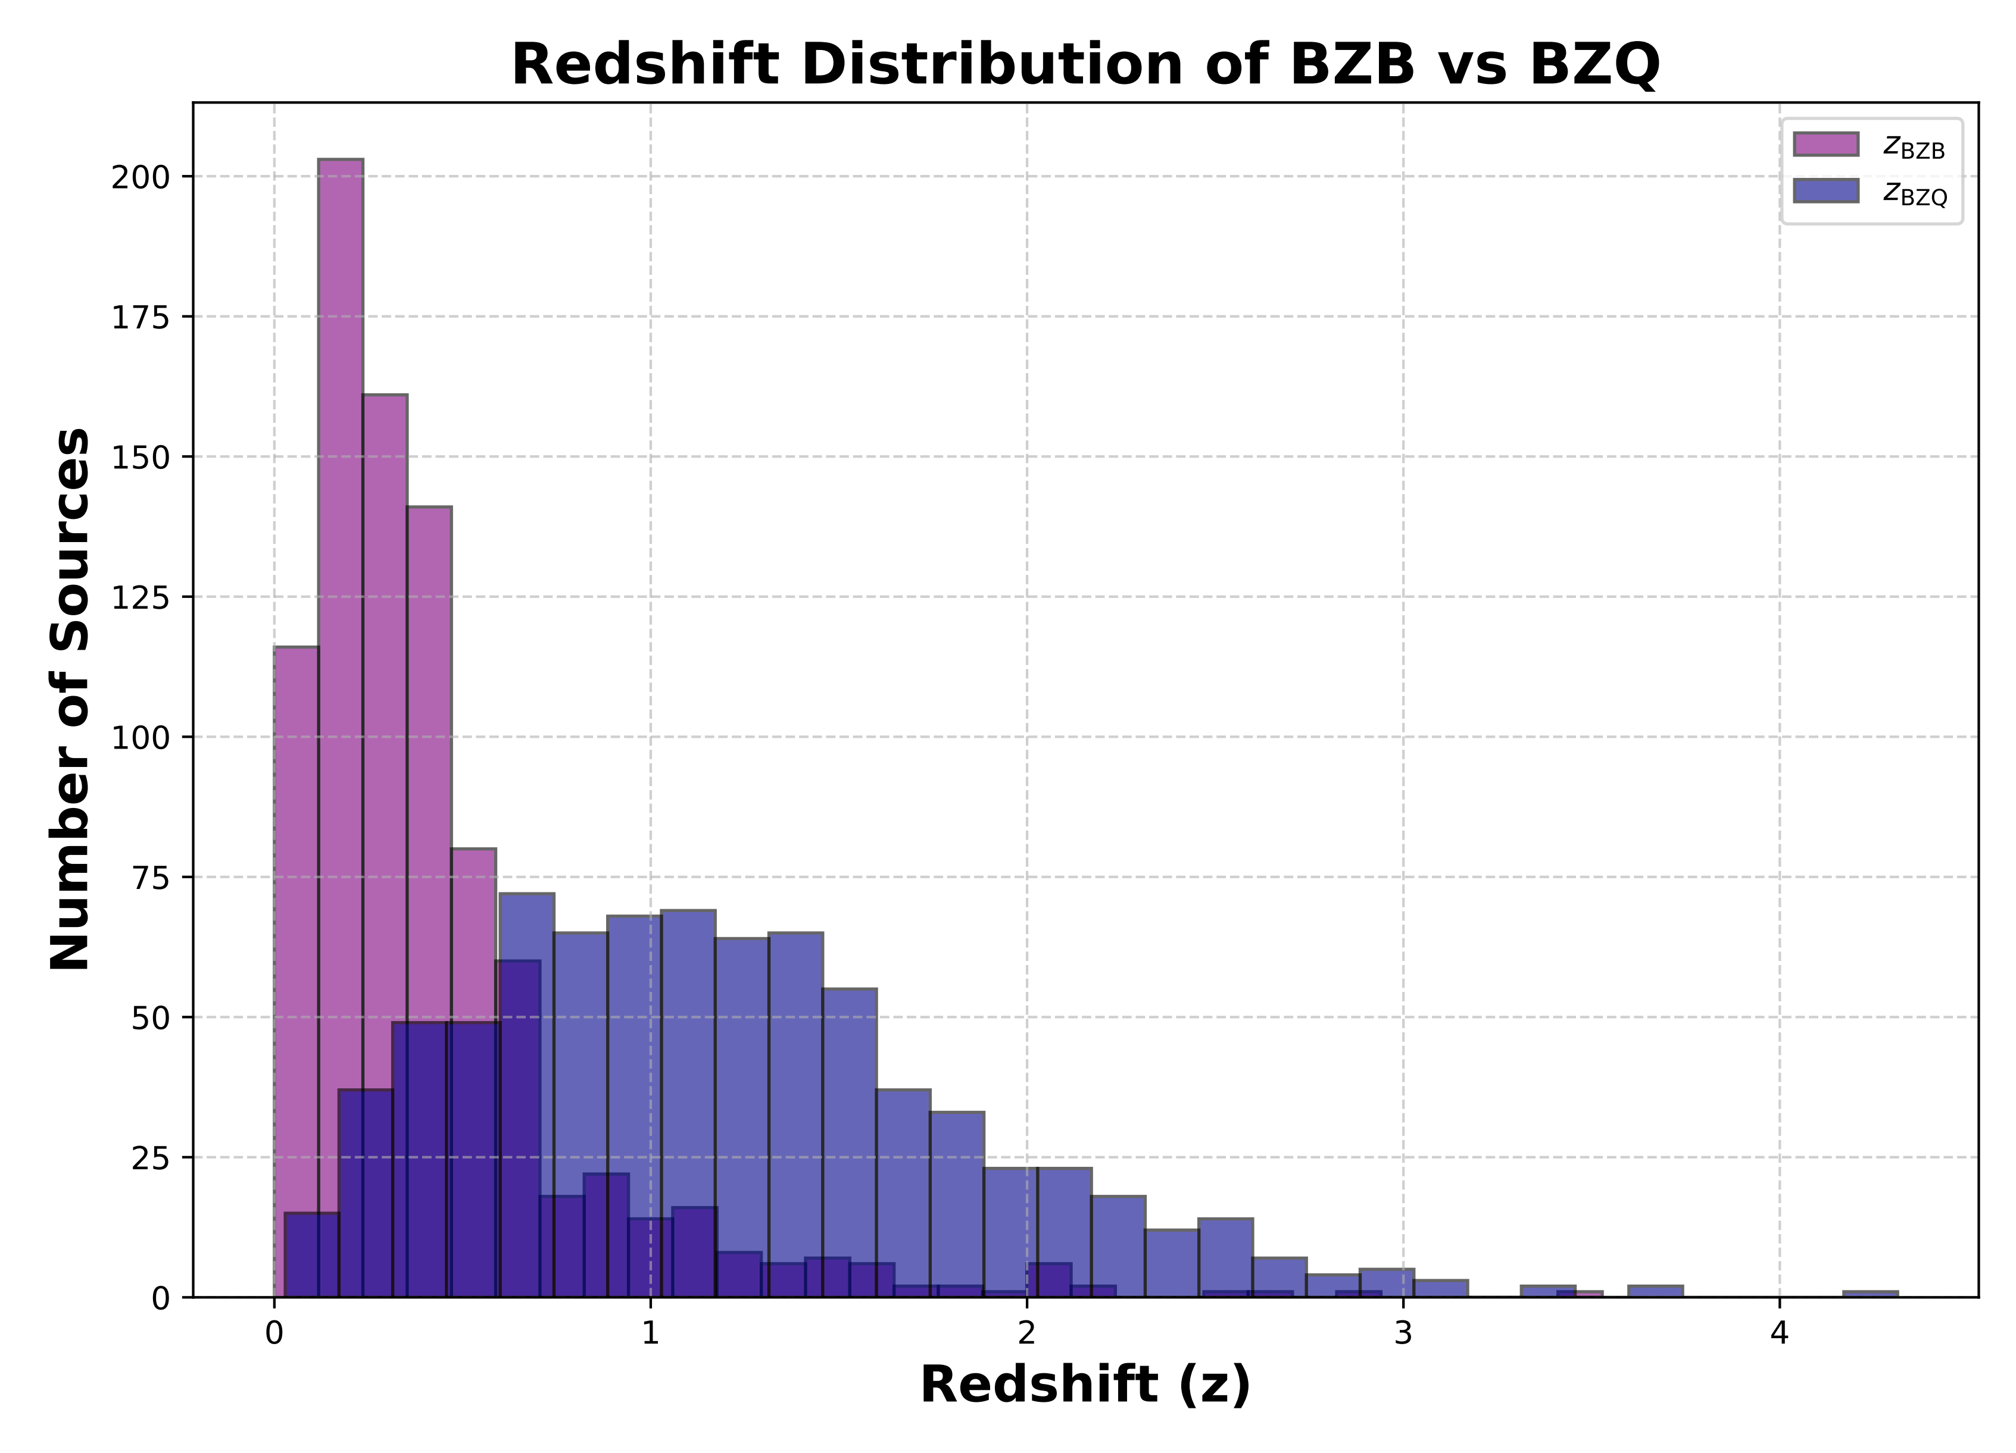
Research Conclusions (8)
(8) For the first time, we use the JSD to compare BZBs and BZQs across synchrotron peak frequency, jet power, Doppler beaming factor, and redshift; all four show JSD > 0.3, indicating strong separations and providing multi-dimensional statistical support for the optically based blazar dichotomy.
The possible physical origin of the differences in multi-band flux distribution
JSD
Synchrotron peak frequency
Jet power
Doppler beaming factor
Redshift

Slide 21
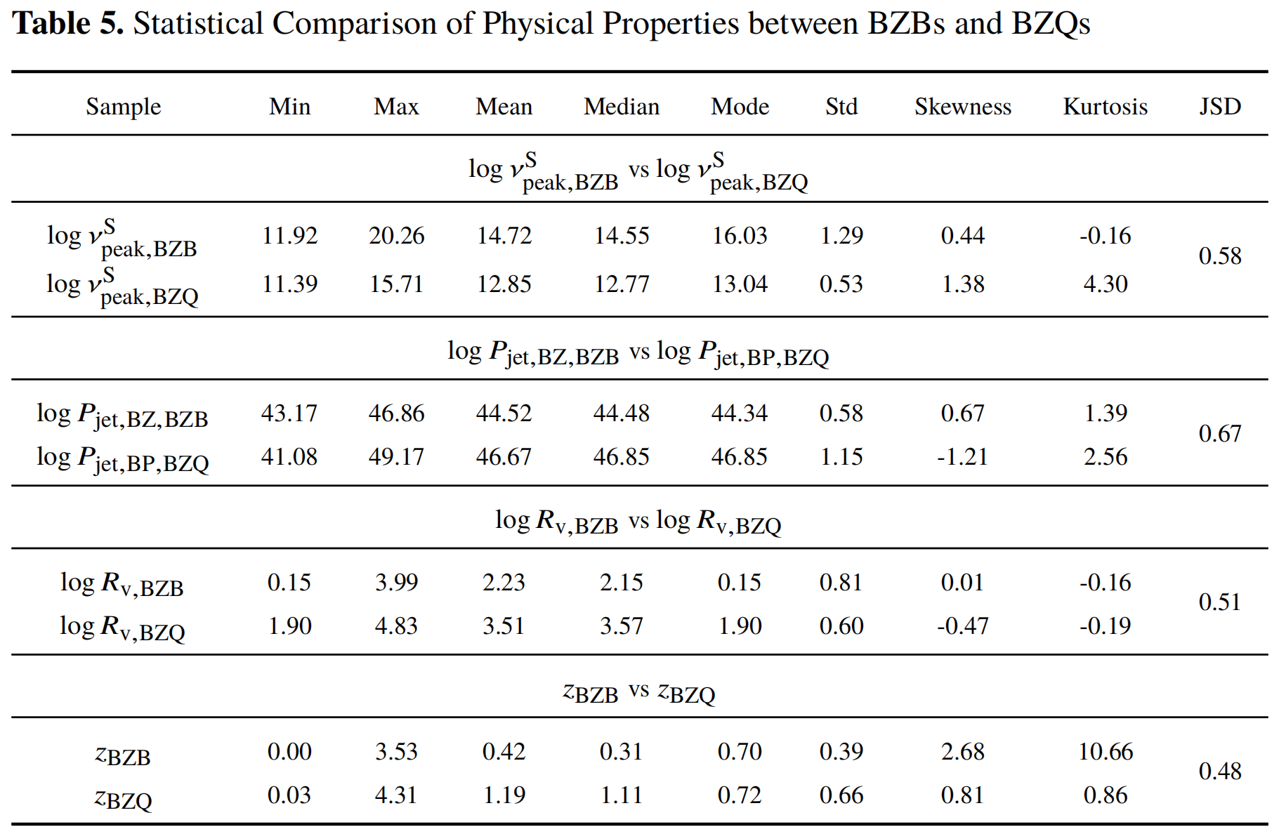
Research Conclusions (8)
(8) For the first time, we use the JSD to compare BZBs and BZQs across synchrotron peak frequency, jet power, Doppler beaming factor, and redshift; all four show JSD > 0.3, indicating strong separations and providing multi-dimensional statistical support for the optically based blazar dichotomy.
Statistical Comparison of Physical Properties between BZBs and BZQs
JSD>0.3
Strong separations
Multi-dimensional statistical support

Slide 22
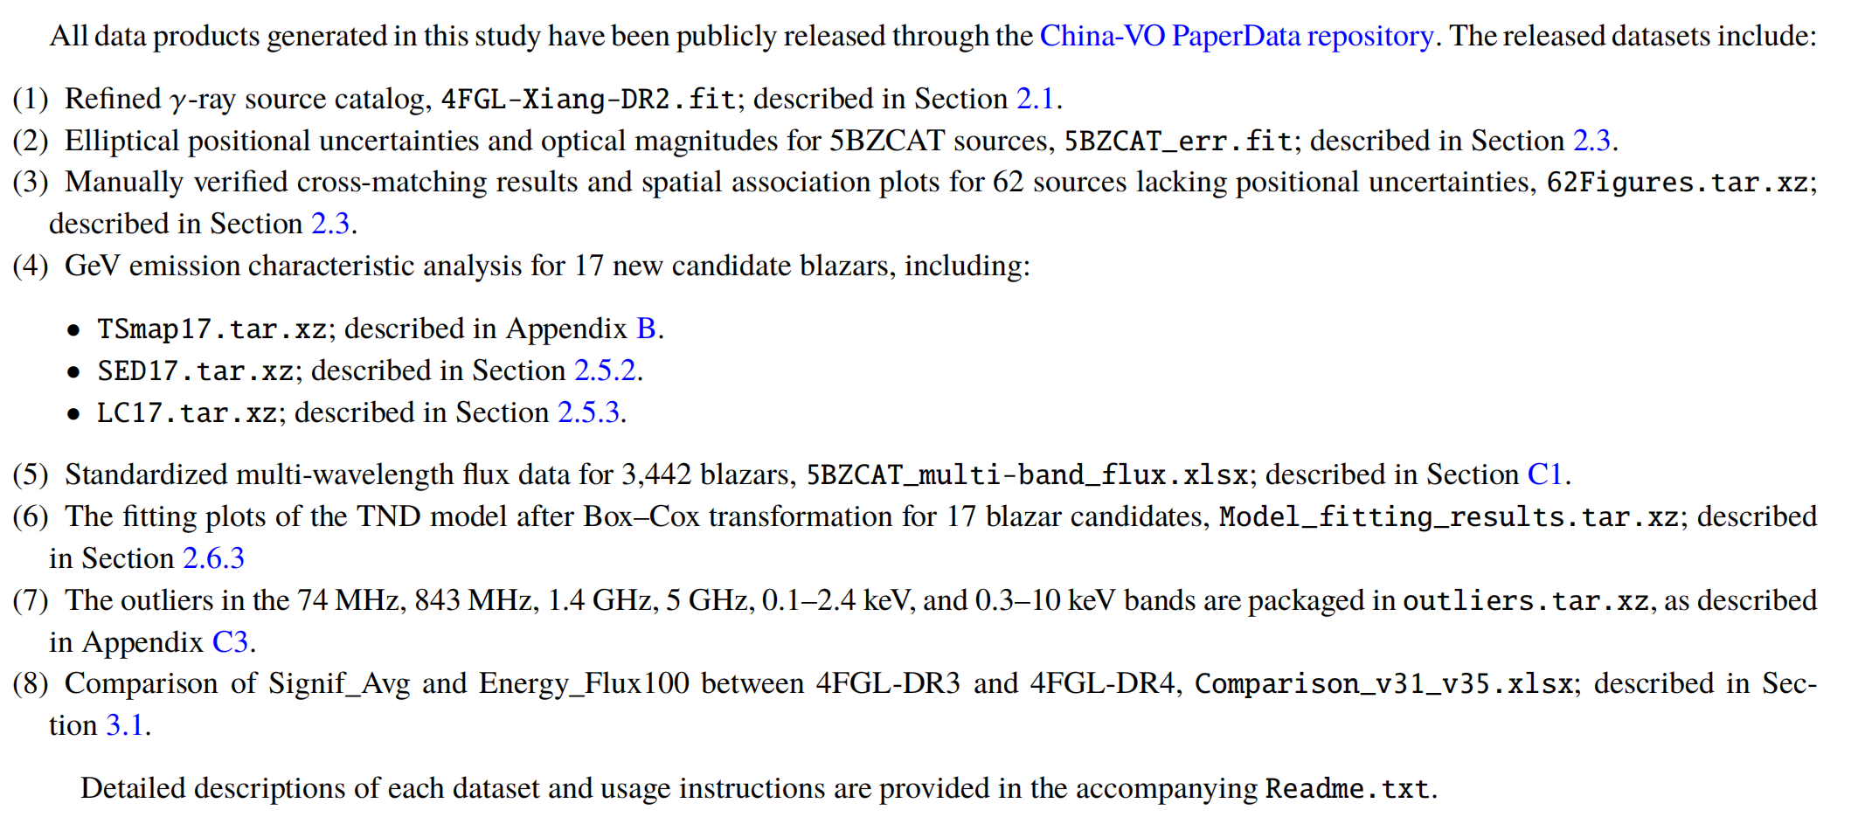
Research Data Products
All data products generated in this study have been
publicly released through the China-VO PaperData repository.

Slide 23
Thanks For Your Attention!

