Slide 1
Temporal evolutions of irradiances and Doppler velocities for 14 confined and pseudo-confined flares

Slide 2
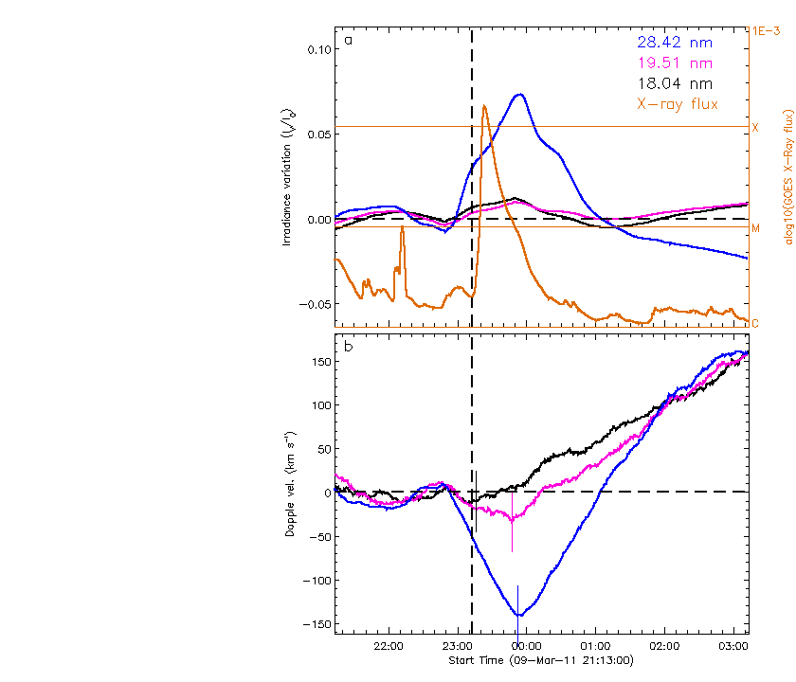
1. 2011/03/09 23:13

Slide 3
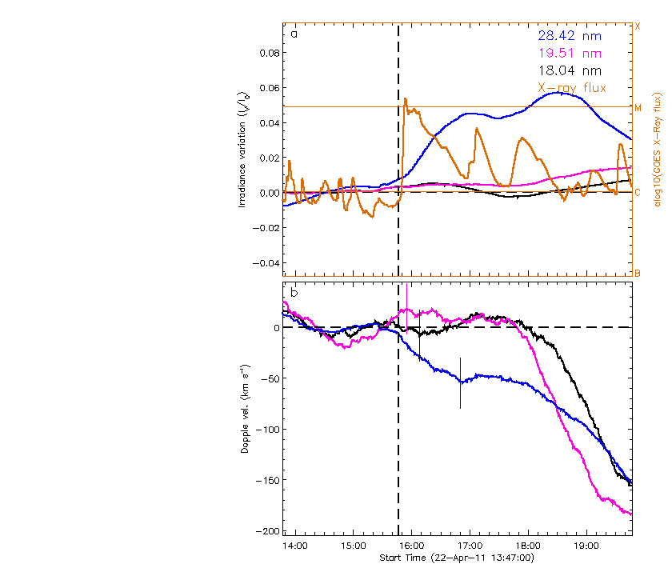
2. 2011/04/22 15:47

Slide 4
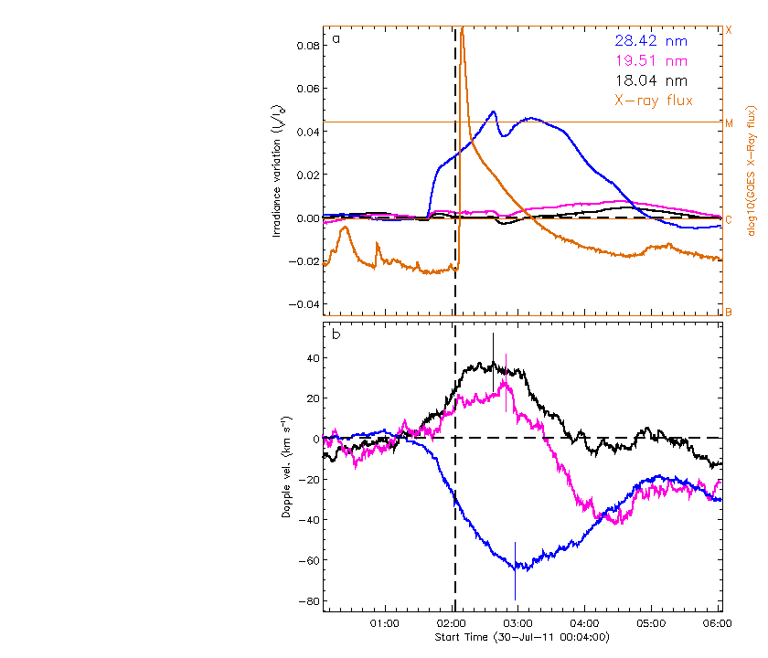
3. 2011/07/30 02:04

Slide 5
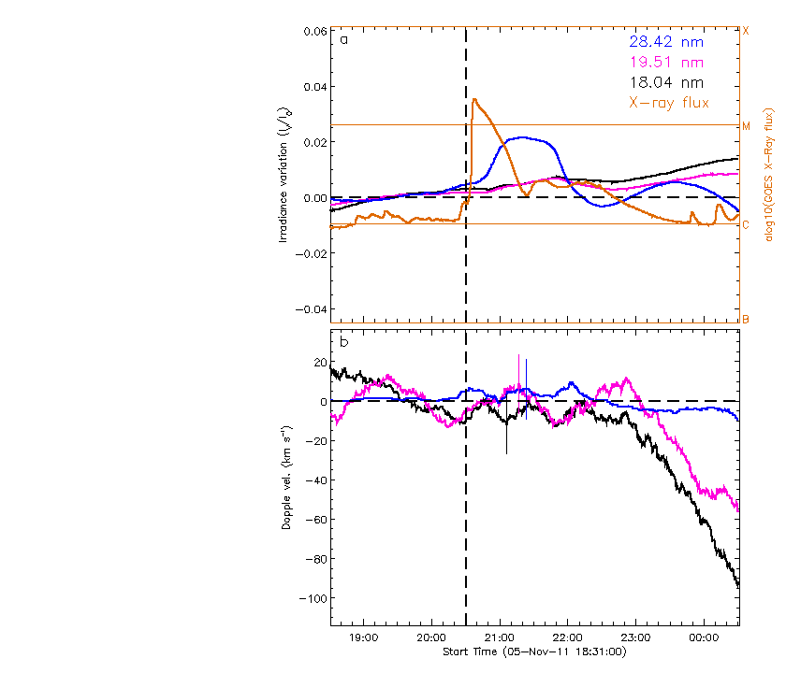
4. 2011/11/05 20:31

Slide 6
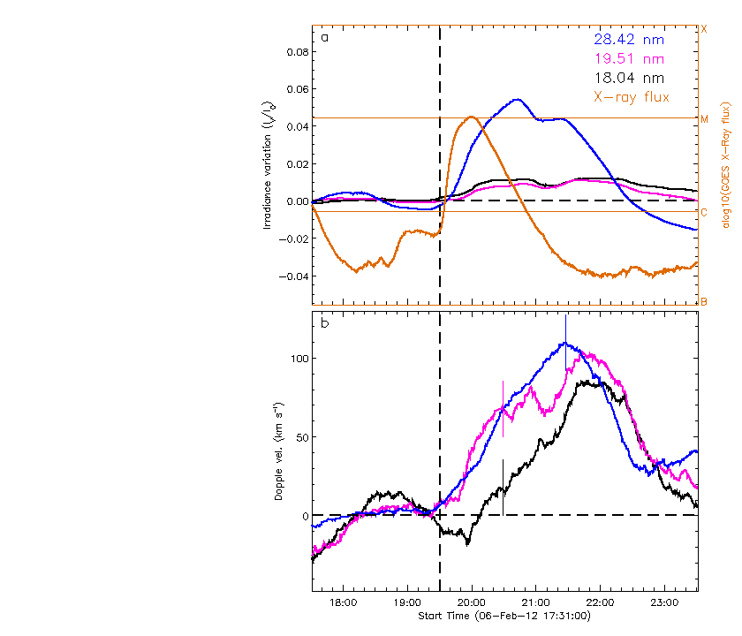
5. 2012/02/06 19:31

Slide 7
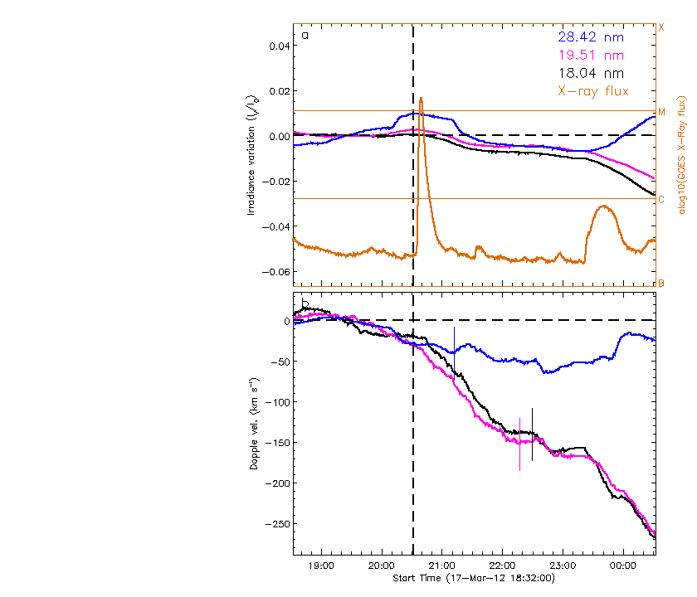
6. 2012/03/17 20:32

Slide 8
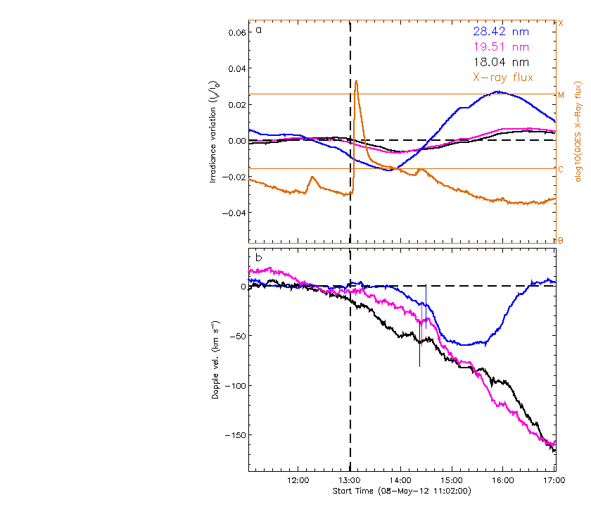
7. 2012/05/08 13:02

Slide 9
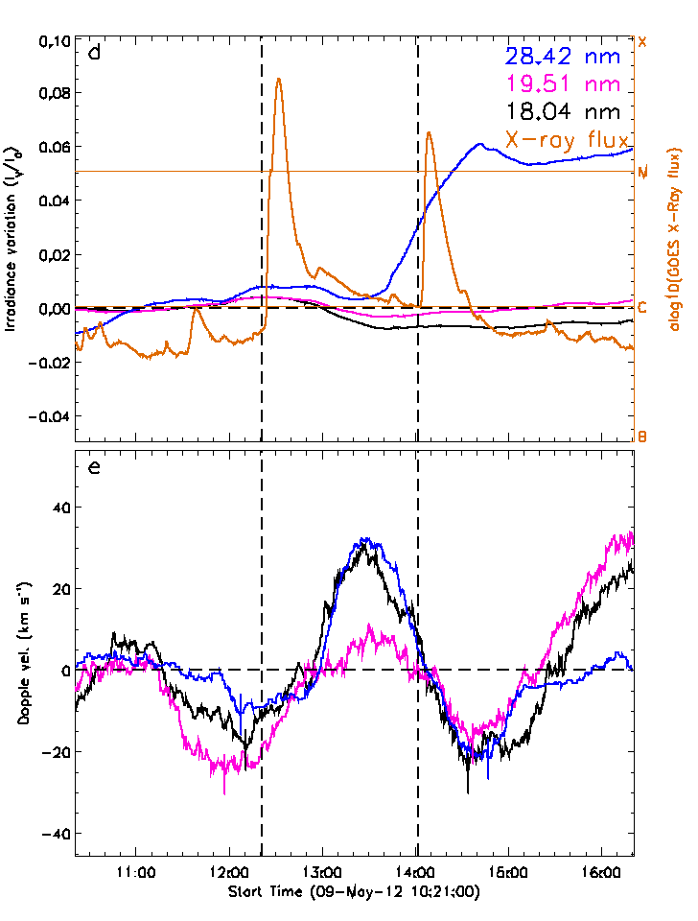
2012/05/09 12:21
2012/05/09 14:02

Slide 10
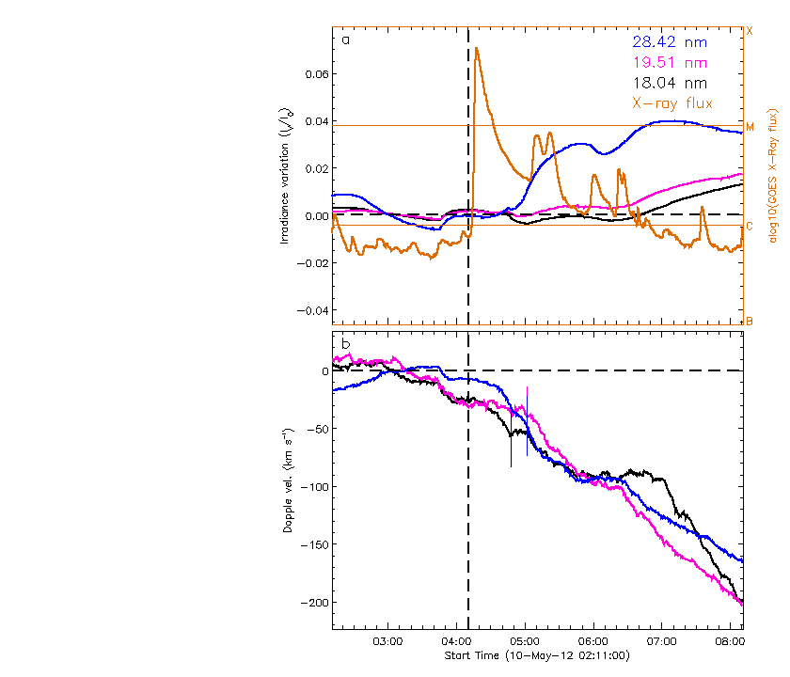
10. 2012/05/10 04:11

Slide 11
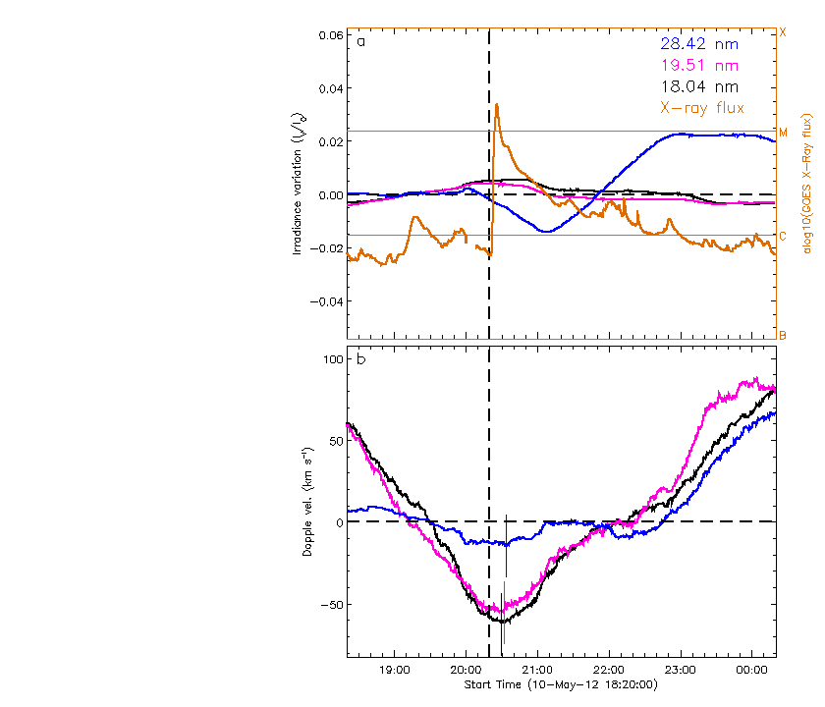
11. 2012/05/10 20:20

Slide 12
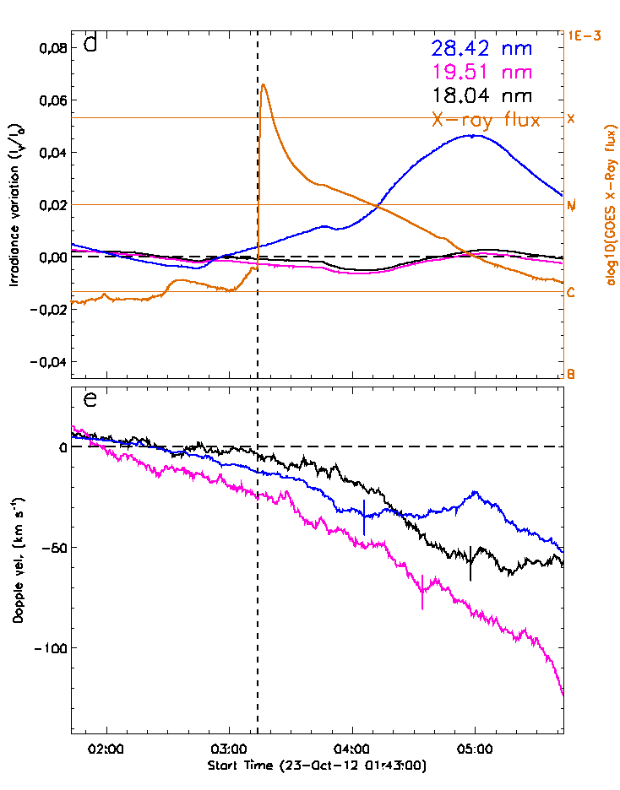
12. 2012/10/23 03:13

Slide 13
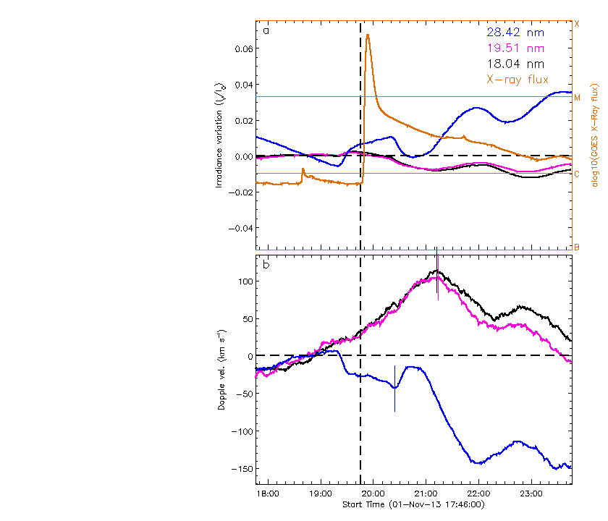
13. 2013/11/01 19:46

Slide 14
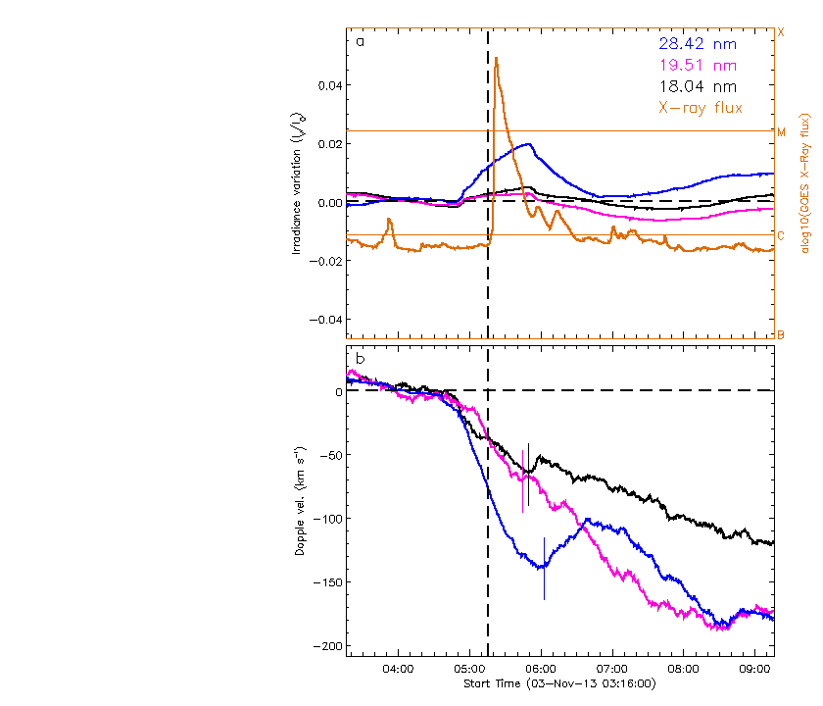
14. 2013/11/03 05:16

