Slide 1
Temporal evolutions of irradiances and Doppler velocities of 26 coronal mass ejections

Slide 2
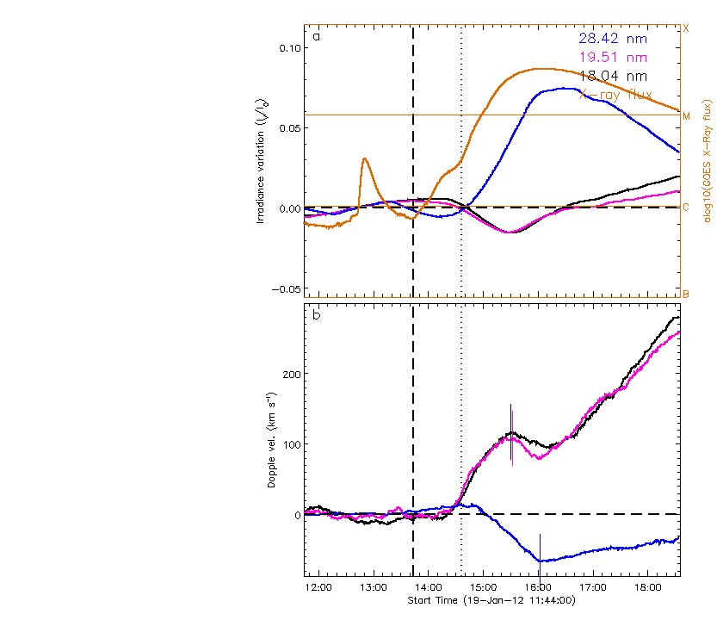
Green arrows indicate CMEs within the searching window
The dashed one means a narrow CME with angular width < 100º
1. 2012/01/19 13:44

Slide 3
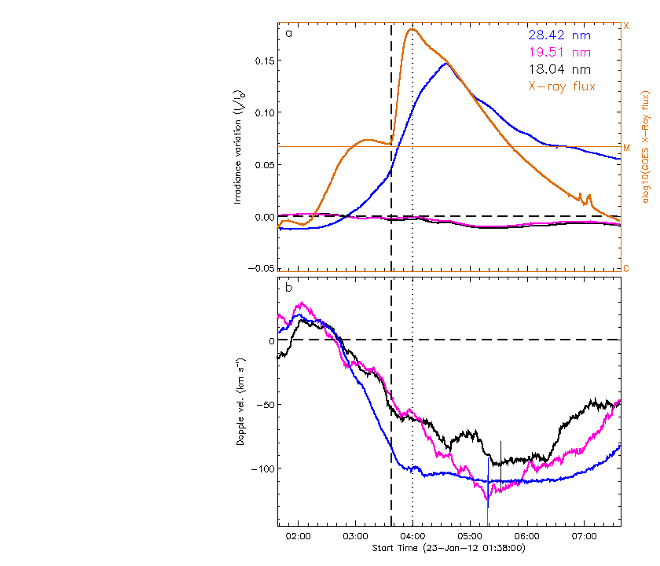
2. 2012/01/23 03:38

Slide 4
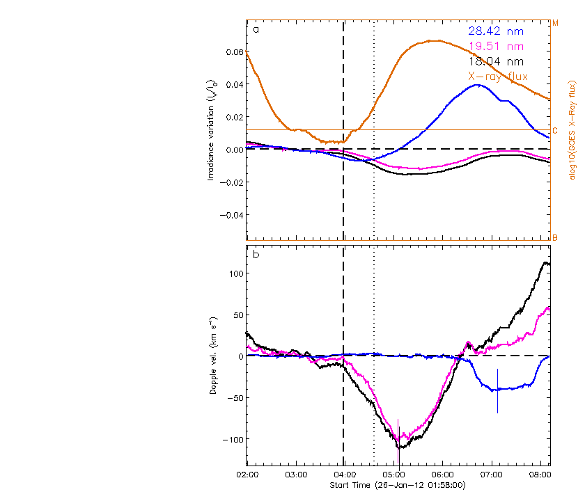
3. 2012/01/26 03:58

Slide 5
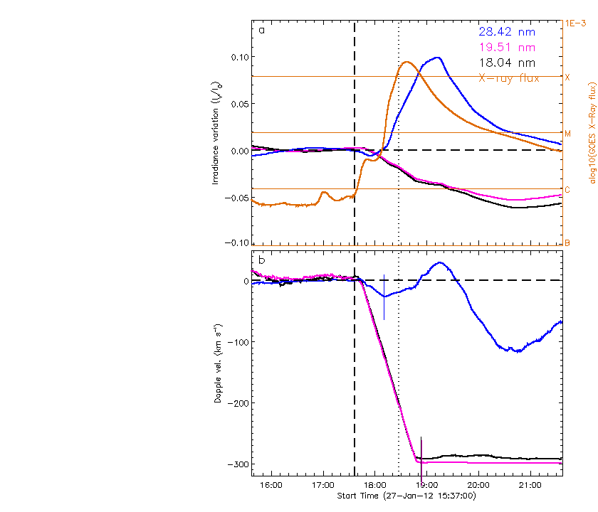
4. 2012/01/27 17:37

Slide 6
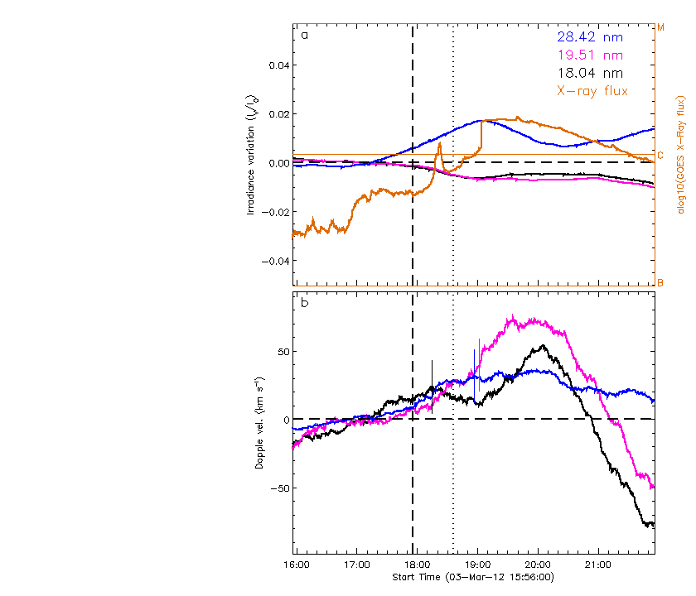
5. 2012/03/03 17:56

Slide 7
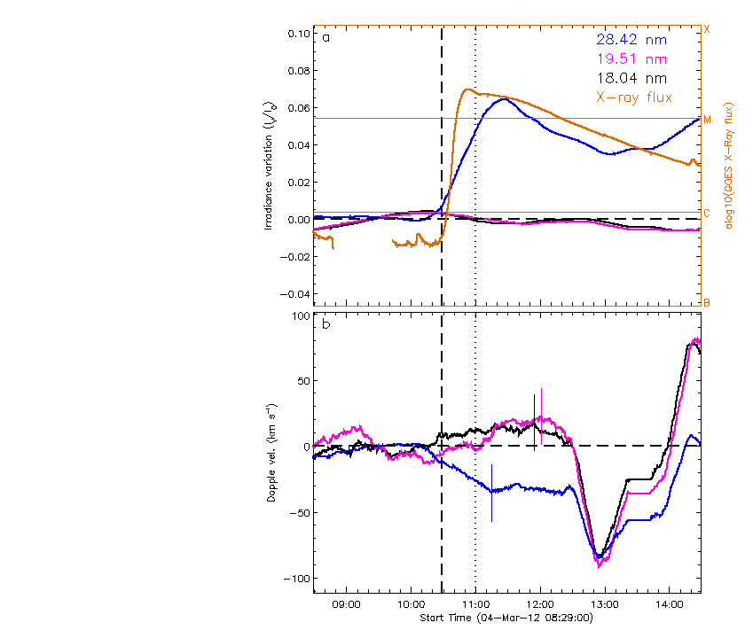
6. 2012/03/04 10:29

Slide 8
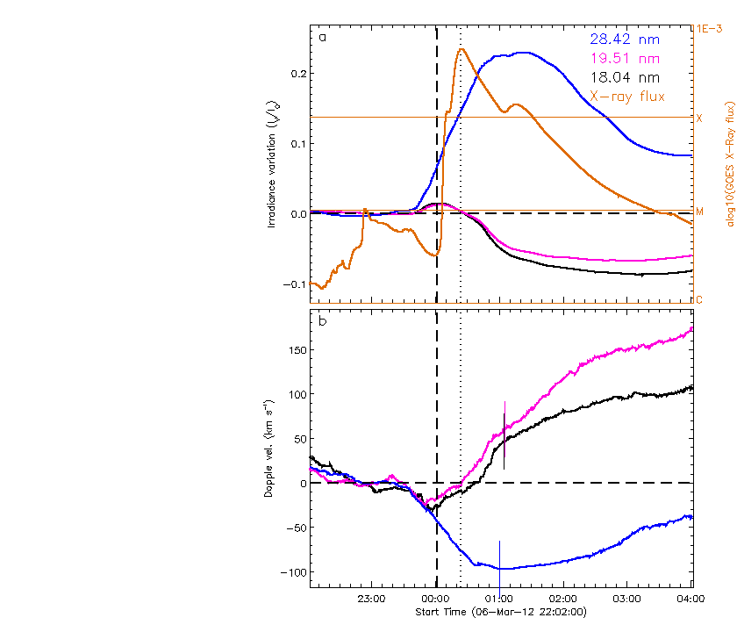
7. 2012/03/07 00:02

Slide 9
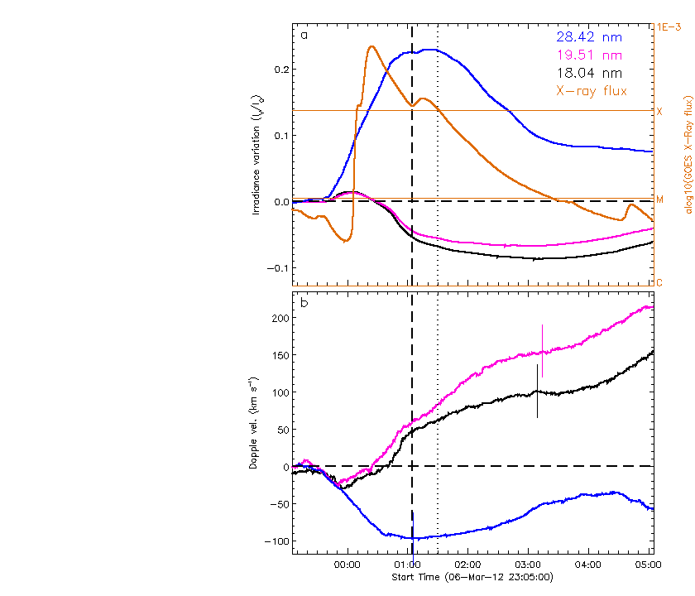
8. 2012/03/07 01:05

Slide 10
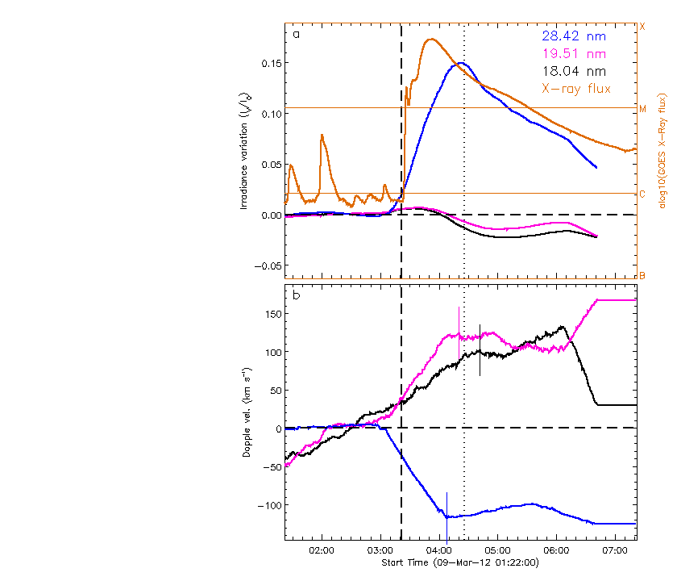
9. 2012/03/09 03:22

Slide 11
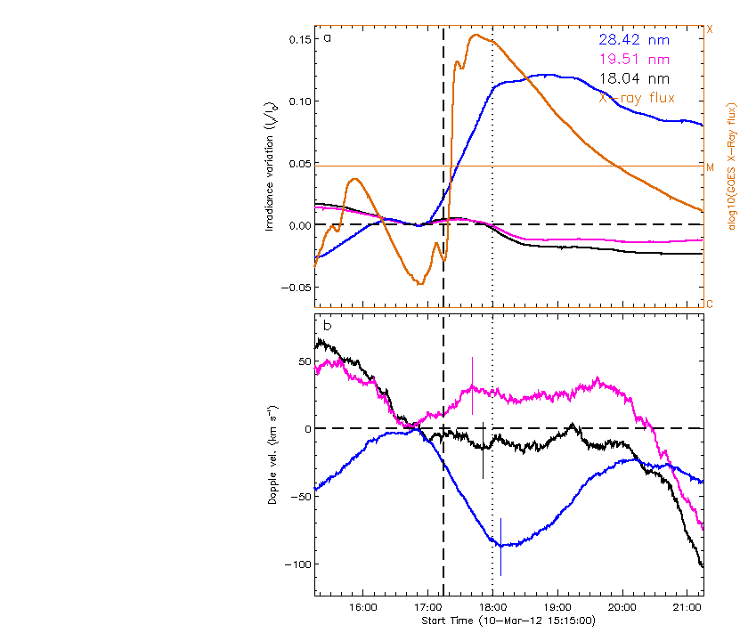
10. 2012/03/10 17:15

Slide 12
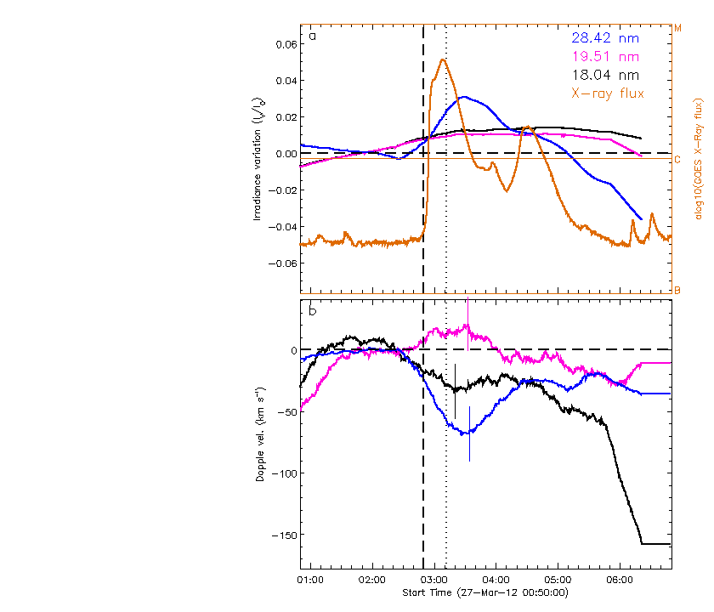
11. 2012/03/27 02:50

Slide 13
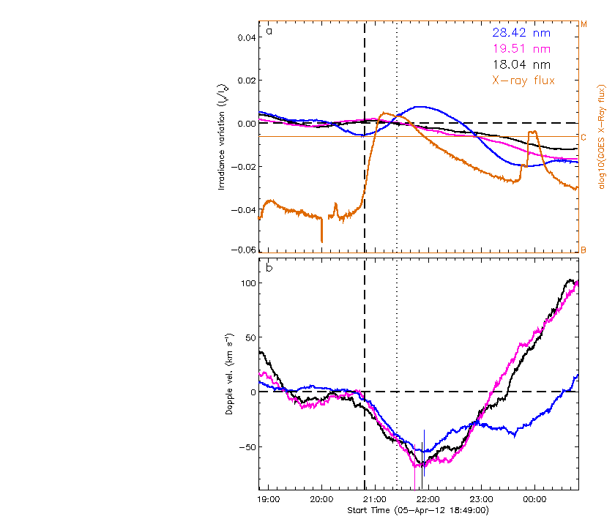
12. 2012/04/05 20:49

Slide 14
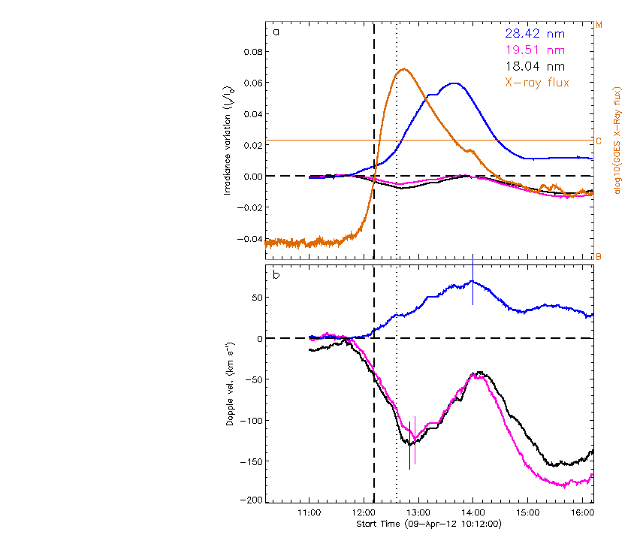
13. 2012/04/09 12:12

Slide 15
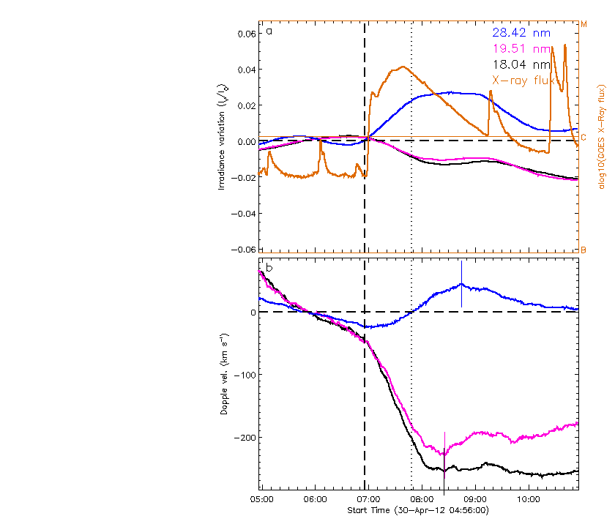
14. 2012/04/30 06:56

Slide 16
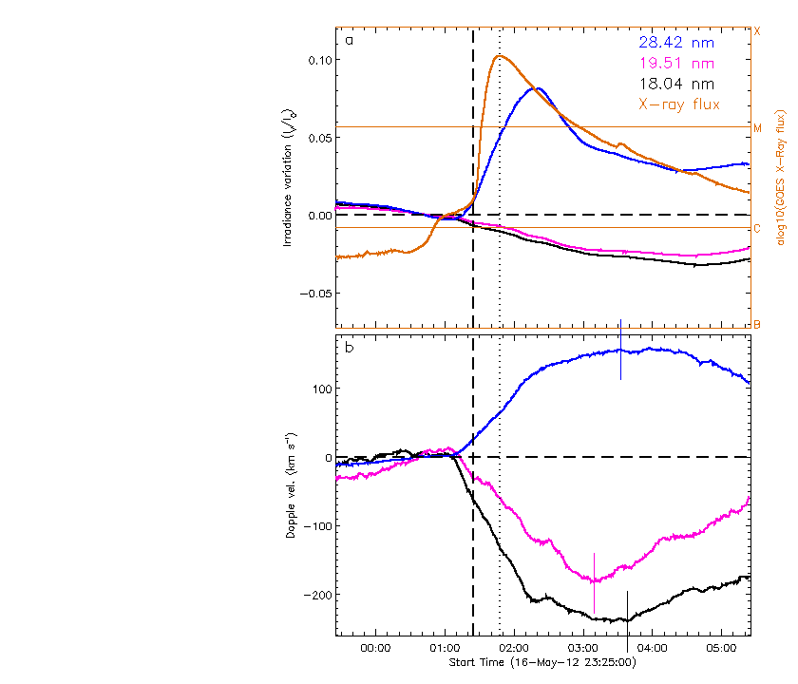
15. 2012/05/17 01:25

Slide 17
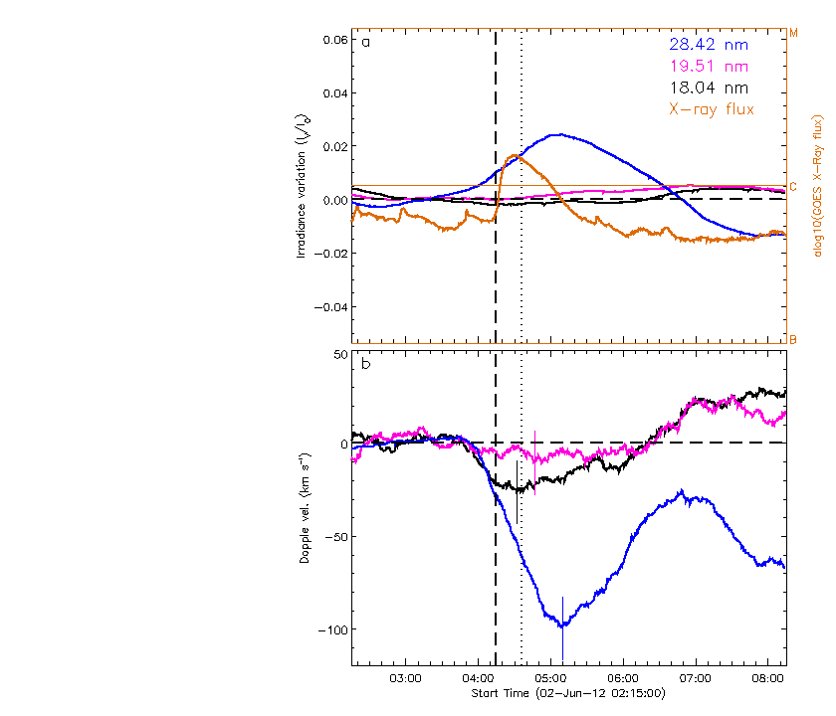
16. 2012/06/02 04:15

Slide 18
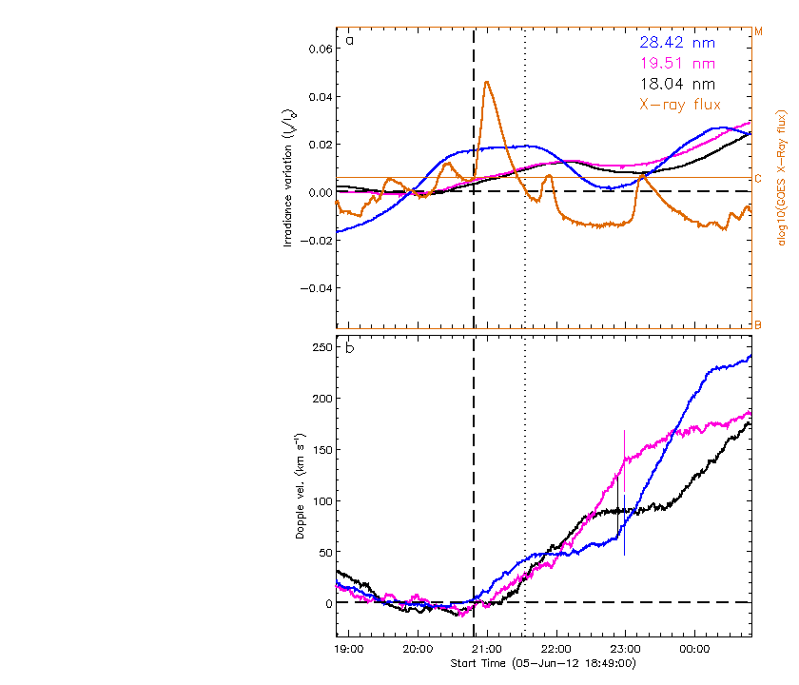
17. 2012/06/05 20:49

Slide 19
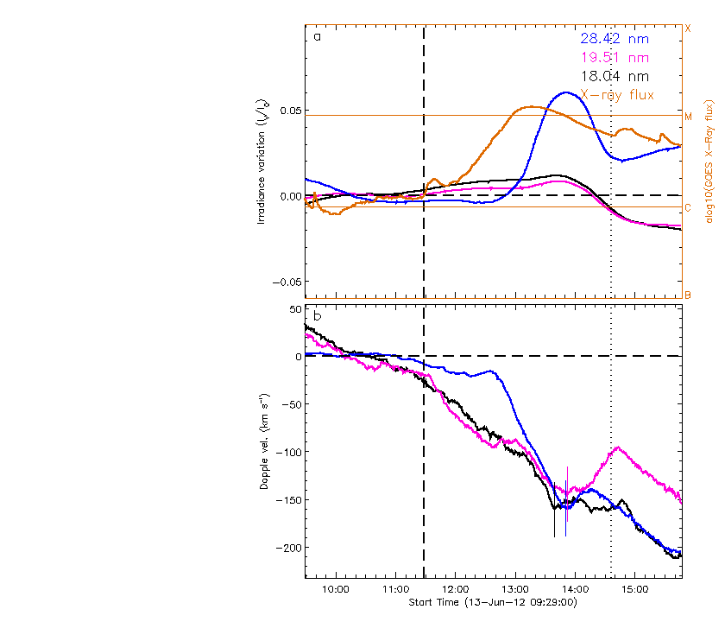
18. 2012/06/13 11:29

Slide 20
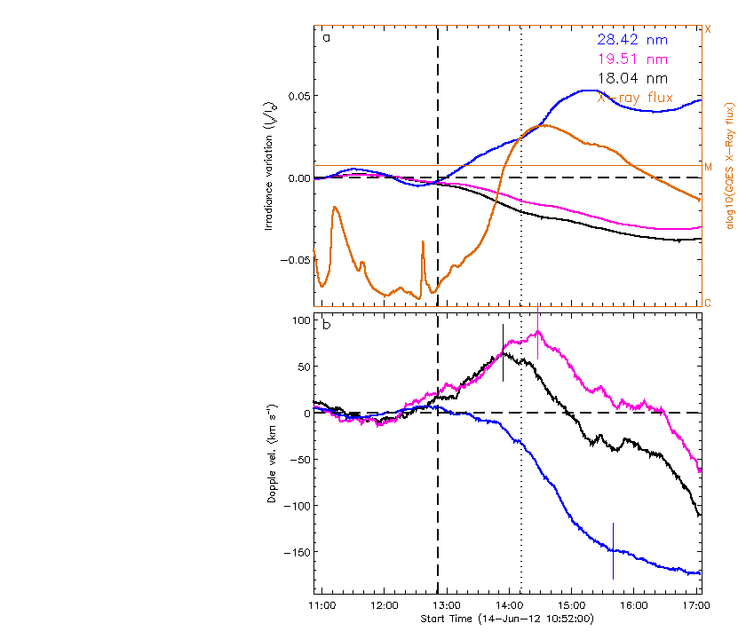
19. 2012/06/14 12:52

Slide 21
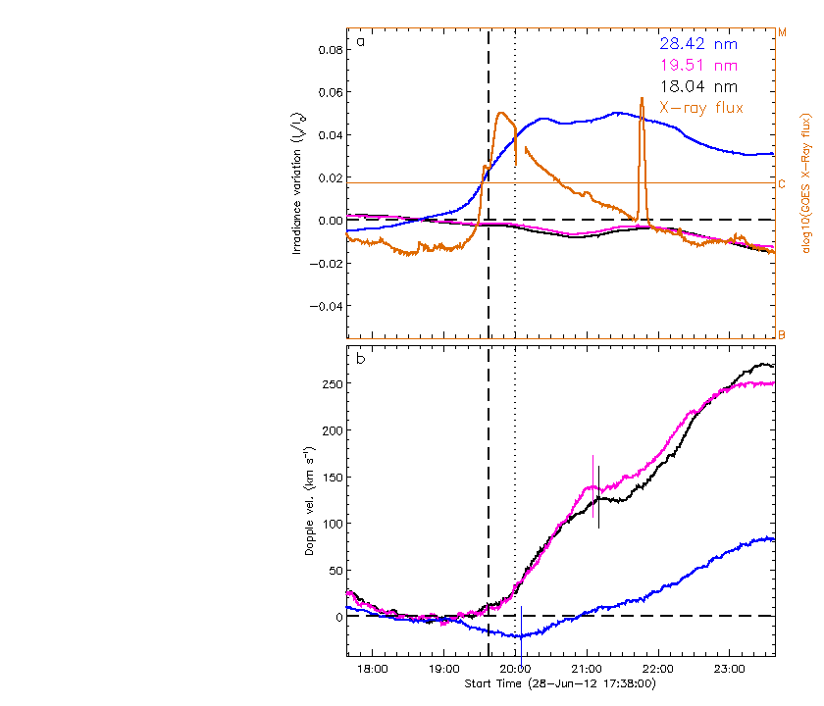
20. 2012/06/28 19:38

Slide 22
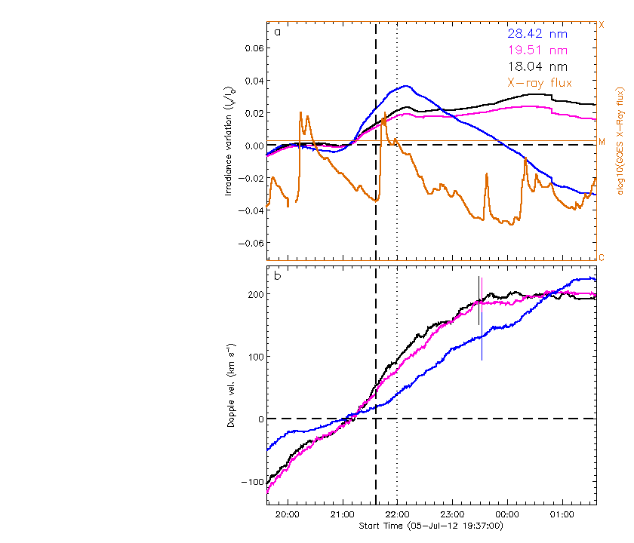
21. 2012/07/05 21:37

Slide 23
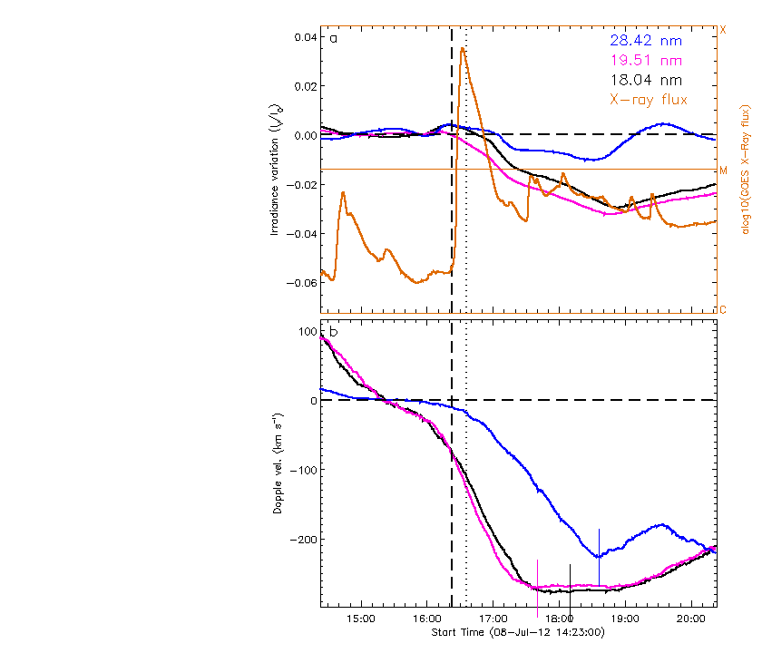
22. 2012/07/08 16:23

Slide 24
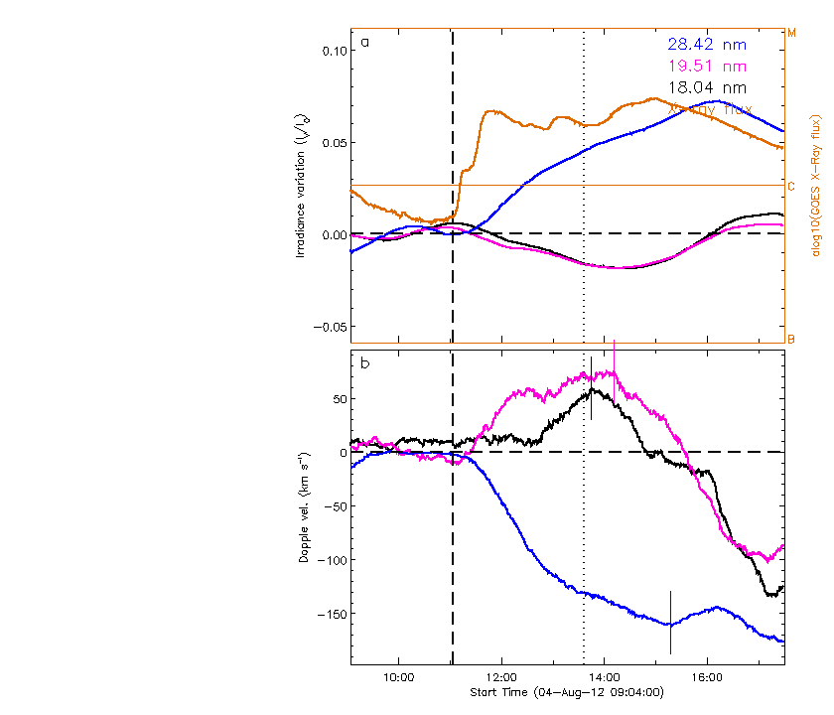
24. 2012/08/04 11:04

Slide 25
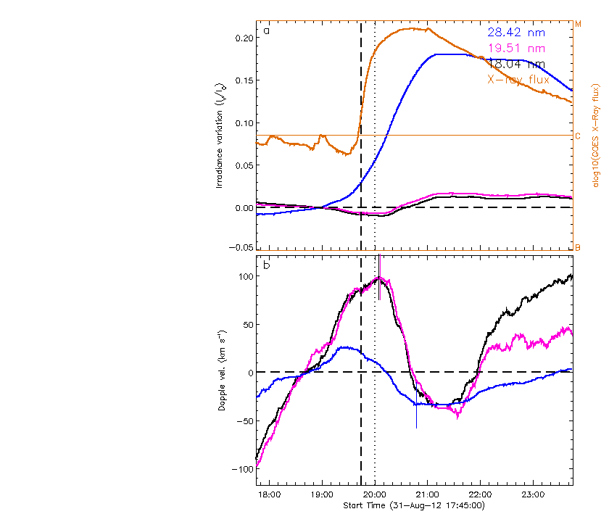
25. 2012/08/31 19:45

Slide 26
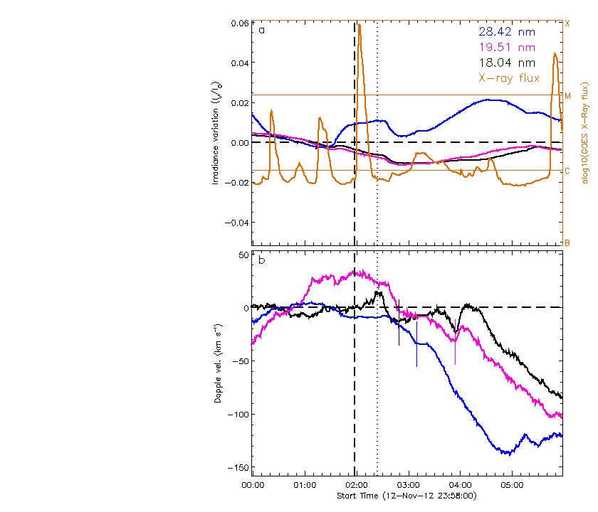
26. 2012/11/13 01:58

